Slide 1
GAARDS
Stephen Langella
Stephen.Langella@osumc.edu
June 2009
http://www.cagrid.org

Slide 2
Outline
Web/Grid Service Security Concepts
GAARDS Overview
Authentication Service
Dorian
Grid Trust Service (GTS)
Grid Grouper
Common Security Module (CSM)
Credential Delegation Service (CDS)
Web Single Sign On (WebSSO)
Deployment
Additional Information

Slide 3
Security Overview
Stephen Langella
Stephen.Langella@osumc.edu
June 2009
http://www.cagrid.org

Slide 4
Fundamental Security Concepts
Communication – Ensuring the integrity and/or privacy of information that is exchanged.
Authentication – The process of proving you are who you say you are or your identity to another party.
Delegation – The process of giving another party rights to act on your behalf.
Authorization – The process of determining whether or not an authenticated party can perform an action or can be granted access to information.

Slide 5
Communication
Communication Concepts
Integrity – Assurance that a sent a message was not altered in any manner.
Privacy – Assurance that a sent message is only readable by the receiving party.
Communication Protocols
HTTPS (Transport Layer Security)
WS Secure Conversation (Message Level Security)

Slide 6
Authentication Overview
Authentication – The process of proving you are who you say you are or your identity to another party.
The Grid uses Public Key Infrastructure (PKI) for authentication.
Public Key Infrastructure (PKI)
Comprehensive security technology and policies using cryptography and standards to enable users to:
Identify (authenticate) themselves to network services.
Digitally sign email and other electronic docs and services.
Encrypt email and other documents to prevent unauthorized access.
Using PKI, each party has a private key and certificate which they use to authenticate with one another.

Slide 7
Authentication Overview
Private Key
A cryptographic key known only to the user, employed in public key cryptography in decrypting or signing information.
Certificate
Data structure (X.509 standard), signed by a Certificate Authority.
Contains the parties public key which is bound to their private key.
Contains information regarding the identity of the party, for example personal identity of server name.
Certificate Authority or asserting party, asserts the identity of the party issued the certificate.
A digital ID Card.
Public
Parties prove their identity to one another by presenting their certificates to one another.
Parties prove that they are the owner of their certificate using their private key.

Slide 8
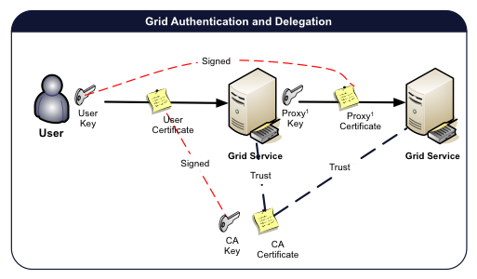
Authentication

Slide 9


Delegation
PKI Review
A PKI Credential consists of a certificate and private key.
Private key is kept “safe” and is used for proving ownership of the certificate (public information).
Federated Query Usecase
How would a federated query service, query other data services on a user’s behalf when it does not have the user’s private key?
Data
Service
Federated
Query
Service
Data
Service

Slide 10
Delegation
Proxy Certificates
Allow users to delegate on the fly by granting other entities the right to use their name
Standardized in IETF/PKIX 2004
Fully implemented, deployed and widely used
Same format as X.509 Public Key Identify Certificate, but signed by user (or another proxy certificate)
Name scoped to issuer’s name
Support restricted delegation from issuer to bearer
Includes critical extension to identify as Proxy and express delegation

Slide 11
Identity Certificate vs Proxy Certificates
Certificate attribute | X.509 Public key certificate | X.509 Proxy Certificates
Issuer/ Signer | A certification authority | A public key certificate or another Proxy Certificate
Name | Any as allowed by issuer’s policy | Unique, scoped to namespace defined by issuer’s name
Delegation from Issuer | None | Allows for arbitrary delegation policies
Key pairs | Uses unique key pair | Uses unique key pair

Slide 12
Sample Delegation Workflow

Slide 13
Delegation, the BIG Picture

Slide 14
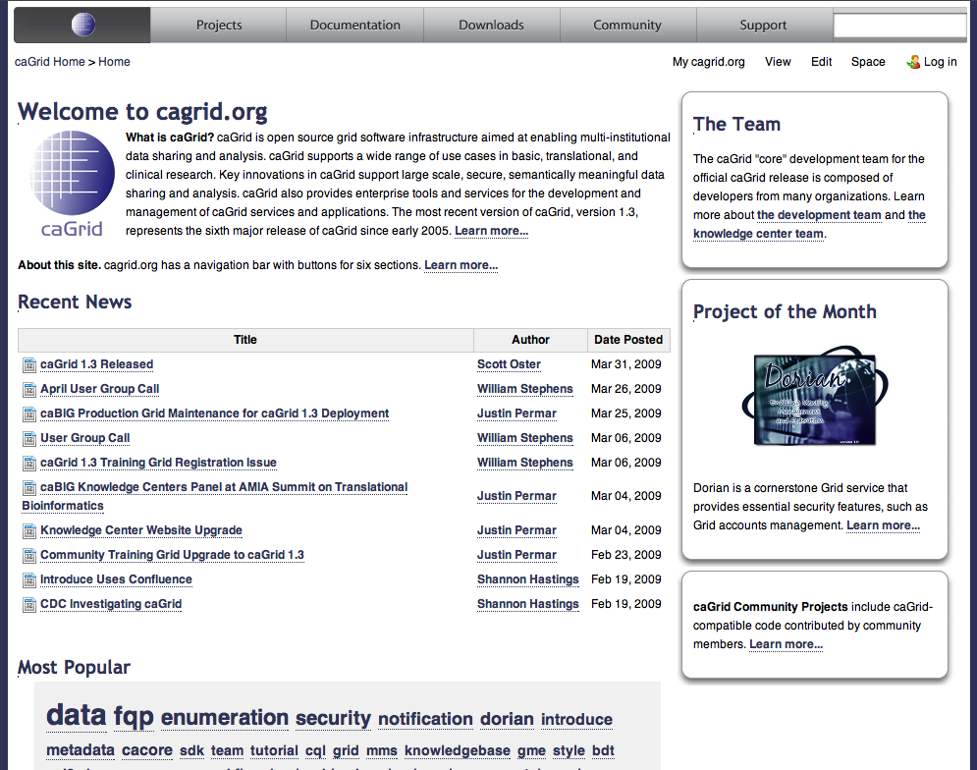
Questions
www.cagrid.org

Slide 15
GAARDS Overview
Stephen Langella
Stephen.Langella@osumc.edu
June 2009
http://www.cagrid.org

Slide 16
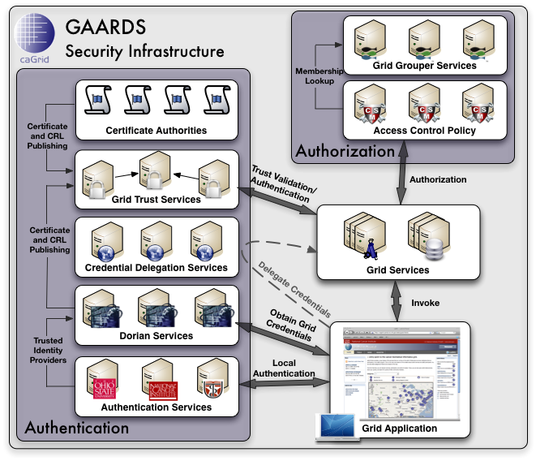
GAARDS Security Infrastructure
GAARDS provides services and tools for the administration and enforcement of security policy in an enterprise Grid.
GAARDS is the security infrastructure for caGrid.

Slide 17
PKI Complexities
User required to manage long term certificate and private key.
How are they obtained?
Traditionally user generate a key pair and certificate request locally, then contact (email) a CA administrator to get a signed certificate.
Mobility Issues
User generally work on more that one computer
Certificate and private key need to be available to users on each machine.
Traditionally users need to copy around certificate and private key.
Hassle for the users, some of which don’t have the expertise to accomplish
Security Concerns.
Identity Vetting is difficult in large federations such as caBIG.
caBIG policies require in person identity vetting.
How do you coordinate in person identity vetting across the federation.
Why cant they leverage their existing accounts to access the grid?

Slide 18

Dorian
Account Management
Administrative interface for account provisioning and management.
Built in Certificate Authority
Manages/Issues PKI Credentials for each user.
Enables users to authenticate and obtain PKI credentials, which they may use to access the grid.
Users may request service/host credentials for the Grid services they administer.
Identity Management and Federation
Integration point between external security domains and the grid.
User may use their existing credentials to authenticate to the Grid.
Automated Account Creation and Provisioning
Built in Identity Provider
Comprehensive Administrative UI

Slide 19
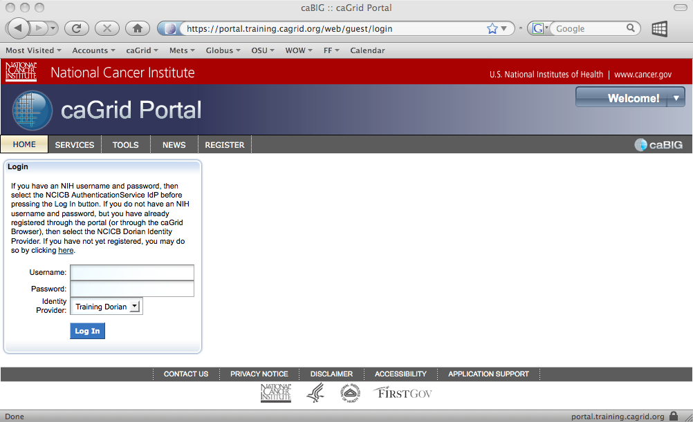
Organizational Identity Providers
Institutions leverage varying technologies for Identity Management
Active Directory
LDAP
Custom / Proprietary / Home Grown
Grid applications cannot be expected to know how to authenticate users with every possible identity management technology.
A standard interface / API is needed such that applications can authenticate users against any identity management technology
OSU
Active
Directory
UT
LDAP

Slide 20
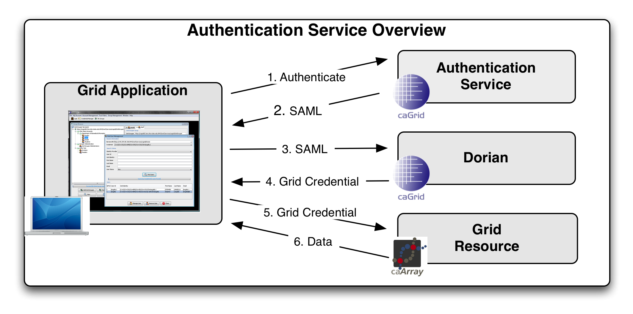
Authentication Service
Provides a uniform web service interface providing applications with a single approach for authenticating users across a federation.
Allows existing identity providers to be seamlessly integrated into a production Grid environment.
Users that are registered with an identity provider may use their existing credentials to access resources on the Grid.
Together the Authentication Service and Dorian provide a solution for federating identity in a grid environment, allowing users to use their existing credentials to access secure grid resources.

Slide 21
How do we know which CAs to Trust?
Should I trust this CA?
Should I trust this CA?

Slide 22
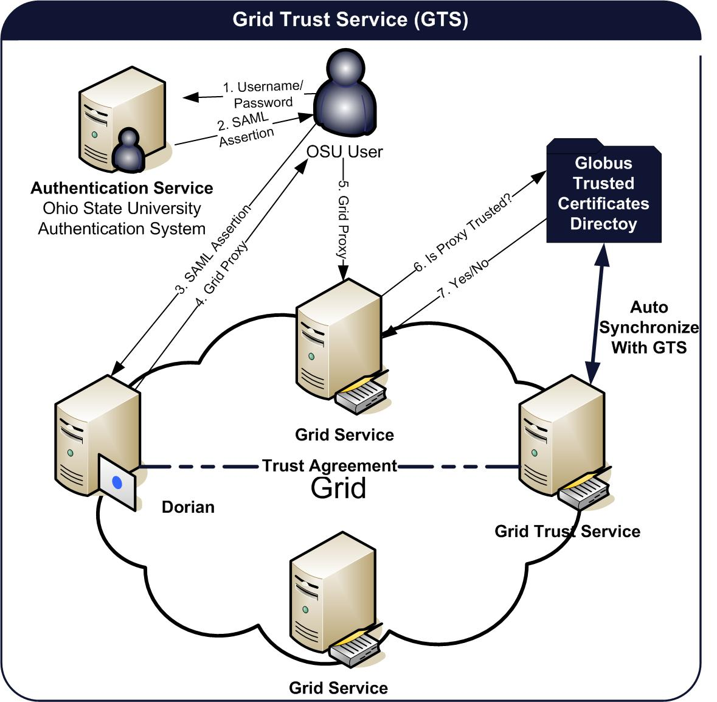
Grid Trust Service (GTS)
Grid Trust Service (GTS)
Creation and Management of a federated trust fabric.
Supports applications and services in deciding whether or not signers of digital credentials can be trusted.
Supports the provisioning of trusted certificate authorities and corresponding CRLS
Define and manage levels of assurance.
Distributed GTS, Enabling the creation of a scalable trust fabric.

Slide 23
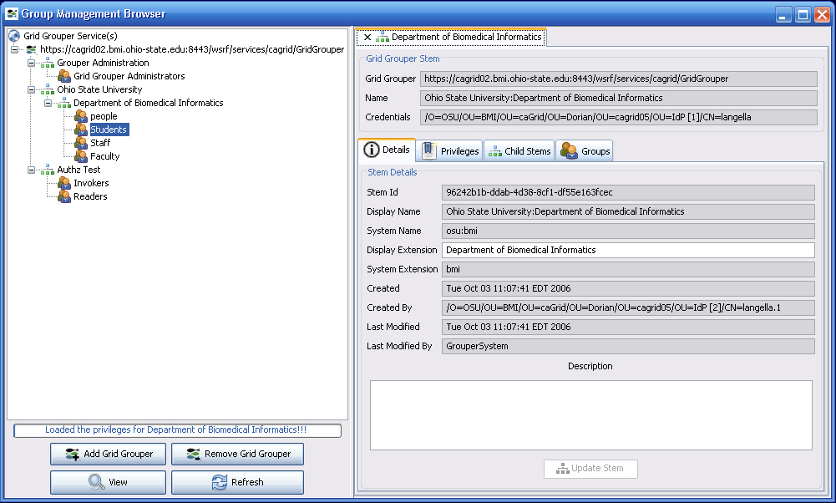
Authorization
GAARDS gives service providers complete control of enforcing access control policy.
Service providers may integrate any authorization/access control system(s).
caGrid provides tools/services for enforcing access control.
Grid Grouper
Group management web service.
Hierarchal organization of groups
Common Security Module (CSM)
Enforces local access control on resources
Policy can be based on groups managed by Grid Grouper

Slide 24
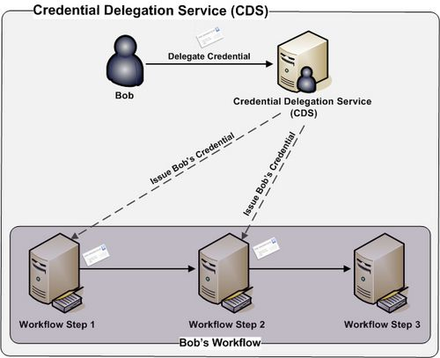
Credential Delegation Service (CDS)
Credential Delegation Service (CDS) - A Web/Grid service that enables users/services (delegator) to delegate their Grid credentials to other users/services (delegatee) such that the delegatee(s) may act on the delegator's behalf.

Slide 25
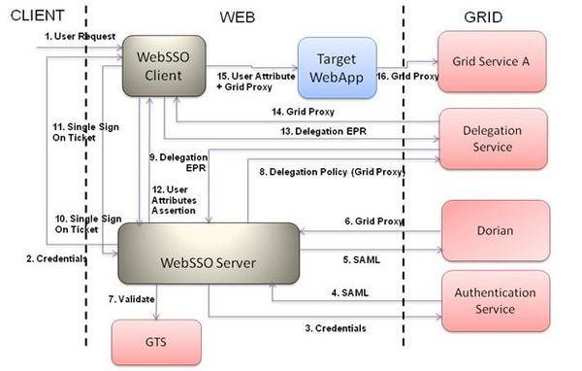
Web Single Sign On (WebSSO)
Provides a comprehensive, Single Sign On (SSO) solution for web applications using GAARDS.
Uses the caGrid’s GAARDS framework in back end to authenticate and validate the user
Allows users to use single set of local credentials to both navigate amongst different web applications and also invoke various grid services
Provides an automated mechanism for delegation and retrieval of user’s grid credentials there by avoiding transfer of grid credentials around

Slide 26
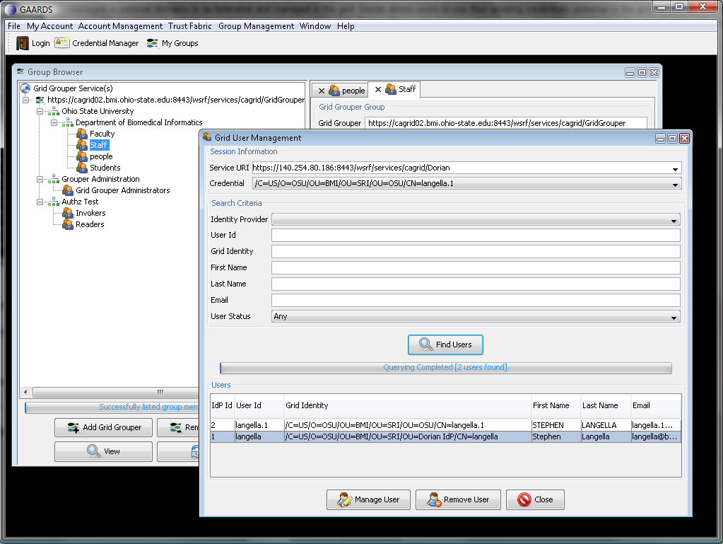
GAARDS Admin UI
GAARDS provides a comprehensive UI for using and administrating GAARDS

Slide 27
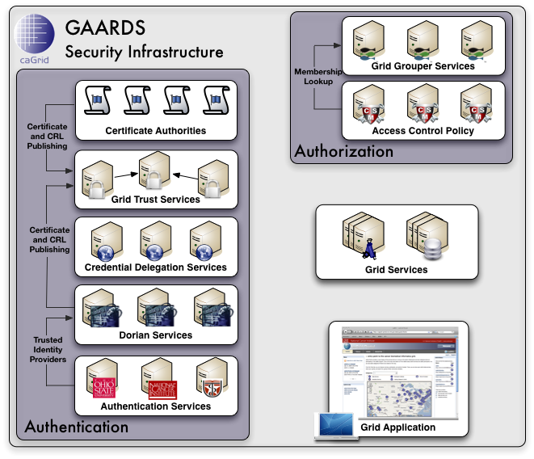
GAARDS In Action
To access secure Grid resources, a user needs to obtain a Grid credential

Slide 28
GAARDS In Action

Slide 29
GAARDS In Action
Authenticate with local institution and obtain proof of authentication (SAML Assertion)

Slide 30
GAARDS In Action
Obtain Grid Credential from Dorian using SAML Assertion

Slide 31
GAARDS In Action
Invoke Secure
Grid Service
Using Credential Provided by Dorian

Slide 32
GAARDS In Action
Validate that the
Credential provided by the user is issued by
a trusted provider

Slide 33
GAARDS In Action
Determine if user is authorized to access requested resources.

Slide 34
GAARDS Security Infrastructure

Slide 35
Questions
www.cagrid.org

Slide 36
Authentication Service
Stephen Langella
Stephen.Langella@osumc.edu
June 2009
http://www.cagrid.org

Slide 37
Organizational Identity Providers
Institutions leverage varying technologies for Identity Management
Active Directory
LDAP
Custom / Proprietary / Home Grown
Grid applications cannot be expected to know how to authenticate users with every possible identity management technology.
A standard interface / API is needed such that applications can authenticate users against any identity management technology
OSU
Active
Directory
UT
LDAP

Slide 38
Authentication Service
Provides a uniform web service interface providing applications with a single approach for authenticating users across a federation.
Allows existing identity providers to be seamlessly integrated into a production Grid environment.
Users that are registered with an identity provider may use their existing credentials to access resources on the Grid.
Together the Authentication Service and Dorian provide a solution for federating identity in a grid environment, allowing users to use their existing credentials to access secure grid resources.

Slide 39
Web Service Interface
SAMLAssertion authenticateUser(Credential credential)
Core authentication method, accepts a credential, returns a signed SAML Assertion if the user could be successfully authenticated.
Throws an error if the user could not be authenticated
Credential, is an extensible object enabling any type of credential to be passed.
Out of the box support for UserId/Password and UserId/Onetime Password.
authenticate() (Deprecated) – Still supported for backwards compatibility with 1.0, 1.1, and 1.2 clients.

Slide 40

Authentication Profiles
Enables the Authentication Service to support multiple mechanisms for Authentication.
Username and Password
One Time Password (Secure Id)
Extensible – additional profiles can be added based on community needs.
Enables organizations to be integrated into the Grid at e-Authentication Levels 2 and 3.

Slide 41
Authentication Profiles
Authentication Profile Metadata
Authentication Service publishes service metadata that describes which authentication profiles is supports.
General user interfaces can be built that provide inputs for the user based on the credential that is required by the Authentication Service
Authentication Service
Authentication Profile
Credential Required by the Authentication Service

Slide 42
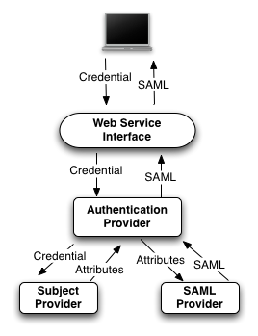
Authentication Service Architecture
Authentication Provider - Responsible for validating the credential provided and for creating and signing the SAML Assertion that proves that the authentication was successful.
Subject Provider - validates the provided credential with organization’s identity provider and obtains the user attributes that are required to be in the SAML Assertion.
SAML Provider - Is responsible for encoding the user attributes provided by the AuthenticationProvider into a SAML Assertion.
Each AuthenticationService component can be replaced with a custom implementation
Authentication Service provides default implementations for all components allowing out of the box integration with some identity providers.

Slide 43
Authentication Service Architecture
Default Implementations
Default Authentication Provider - Delegates the authentication of users to a SubjectProvider (see Subject Provider). Upon successfully authenticating a user, the SubjectProvider provides the Default AuthenticationProvider with the attribute required to issue the assertion, which it in turns passes to a SAMLProvider (see SAML Provider) who in turn issues the SAMLAssertion and signs it.
Default Subject Provider - Provides out of the box capability for authenticating users and obtaining user attributes with LDAP based identity providers.
Default SAML Provider -Provides an out of the box solution for issuing the required SAML Assertions. The Default SAML Provider uses a user configured certificate and private key for issuing and signing SAML assertions.

Slide 44
Implementation Approaches
1: Implement the Authentication Provider
This option should used in the case where the Identity Provider being integrated has the ability to authenticate users and issue Dorian-compliant SAML Assertion.
2: LDAP Based Identity Providers (Default Authentication Provider and Default Subject Provider)
This option should be used in the case where your Identity Provider is LDAP based system and is not capable of issuing SAML Assertions.
3: Default Authentication Provider and Custom Subject Provider
This option should be used in the case where your Identity Provider is NOT and LDAP based system and is NOT capable of issuing SAML Assertions. (ex Kerberos/LDAP)

Slide 45
Approach 1 Implement the Authentication Provider
This option should used in the case where the Identity Provider being integrated has the ability to authenticate users and issue Dorian-compliant SAML Assertion (i.e. Shibboleth)
Requires implementation of the AuthenticationProvider interface.
Implement a Single Method (authenticate)
Validates a provide credential.
Returns a signed SAML Assertion specifying information about the user and that they successfully authenticated.
SAMLAssertion authenticate(Credential credential)

Slide 46
Approach 2 LDAP Based Identity Providers
This option should used for LDAP Based Identity Providers. It uses the Authentication Service’s default implementations,
No implementation required
Configuration Only (.java.login.config)
myapp{
gov.nih.nci.security.authentication.loginmodules.LDAPLoginModule required
ldapHost="ldaps://ldap.example.edu:636"
ldapSearchableBase="DC=xyz,DC=abc"
ldapUserIdLabel="sAMAccountName"
ldapAdminUserName="CN=CABIG,OU=Authentication Accounts,DC=xyz,DC=abc"
ldapAdminPassword=“password”
USER_FIRST_NAME="givenName"
USER_LAST_NAME="sn"
USER_EMAIL_ID="mail";
};

Slide 47
Approach 3 Implement the Subject Provider
This option should be used in the case where your Identity Provider is NOT and LDAP based system and is NOT capable of issuing SAML Assertions. (i.e. Kerberos/LDAP)
Requires implementation of the SubjectProvider interface.
Implement a Single Method (authenticate)
Validates a provide credential.
If the credential is valid, as JASS Subject is returned
User Id
First Name
Last Name
Email Address
Subject getSubject(Credential credential)

Slide 48
Web Service Interface
SAMLAssertion authenticateUser(Credential credential)
Core authentication method, accepts a credential, returns a signed SAML Assertion if the user could be successfully authenticated.
Throws an error if the user could not be authenticated
Credential, is an extensible object enabling any type of credential to be passed.
Out of the box support for UserId/Password and UserId/Onetime Password.
authenticate() (Deprecated) – Still supported for backwards compatibility with 1.0, 1.1, and 1.2 clients.

Slide 49
Questions
www.cagrid.org

Slide 50
Dorian
Stephen Langella
Stephen.Langella@osumc.edu
June 2009
http://www.cagrid.org

Slide 51
Identity Management and Federation
A system that allows individuals to use the same user name, password or other personal identification to sign on to the systems of more than one enterprise in order to conduct transactions.
Enable users to use their institution provided identity for authenticating to a Grid.
User should be able to authenticate to the Grid using their institution’s existing mechanisms.

Slide 52
Identity Management and Federation
Identity Provider (IdP)
Federation partner that vouches for the identity of a user. The Identity Provider authenticates the user, and provides an authentication token to the service provider.
The identity provider either directly authenticates the user, such as by validating a user name and password, or by indirectly authenticating the user, by validating an assertion about the user's identity, as presented by a separate identity provider.
The identity provider handles the management of user identities in order to free the service provider from this responsibility.
Enable users to use their institution provided identity for authenticating to a Grid.

Slide 53
Grid Account Management is Difficult
User required to manage long term certificate and private key.
How are they obtained?
Traditionally user generate a key pair and certificate request locally, then contact (email) a CA administrator to get a signed certificate.
Mobility Issues
User generally work on more that one computer
Certificate and private key need to be available to users on each machine.
Traditionally users need to copy around certificate and private key.
Hassle for the users, some of which don’t have the expertise to accomplish
Security Concerns.
Difficult to administrate
Few tools for administrate provisioning of user accounts.
Difficult to revoke accounts
Limited information available to administrators for making decisions
Why cant they leverage their existing accounts to access the grid?

Slide 54
Dorian
Account Management
Administrative interface for account provisioning and management.
Built in Certificate Authority
Manages/Issues PKI Credentials for each user.
Enables users to authenticate and obtain PKI credentials, which they may use to access the grid.
Users may request service/host credentials for the Grid services they administer.
Identity Management and Federation
Integration point between external security domains and the grid.
User may use their existing credentials to authenticate to the Grid.
Automated Account Creation and Provisioning
Built in Identity Provider
Comprehensive Administrative UI

Slide 55
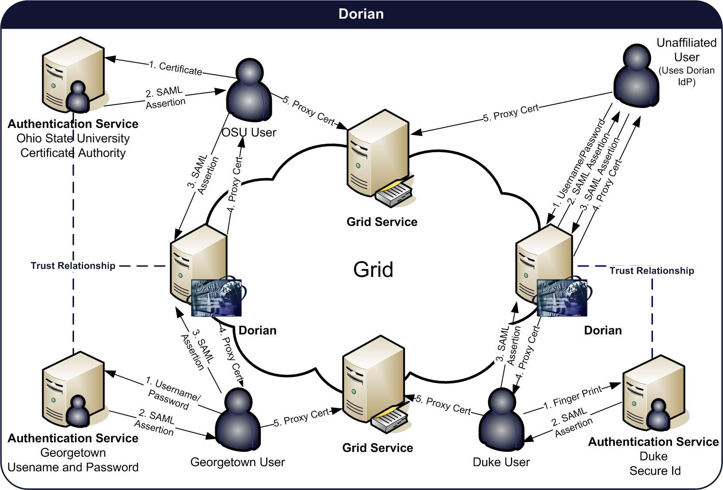
Dorian

Slide 56
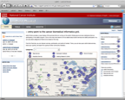



Credential Creation Workflow
Short Term Certificate
Authentication Service
Dorian
Grid Service

Slide 57
Credential Creation Workflow
*** User authenticates with their organization using there everyday credentials ***
Short Term Certificate
Credential
Authentication Service
Dorian
Grid Service

Slide 58
Credential Creation Workflow
*** Authentication Service provides SAML Assertion proving authentication***
Short Term Certificate
SAML
Assertion
Authentication Service
Dorian
Grid Service

Slide 59
Credential Creation Workflow
*** Client generates key pair which will make up proxy/short term certificate***
Short Term Certificate
SAML
Assertion
Key
Pair
Authentication Service
Dorian
Grid Service

Slide 60
Credential Creation Workflow
*** Client sends SAML Assertion and Public Key to Dorian***
Short Term Certificate
Private
Key
Authentication Service
SAML
Assertion
Public
Key
Dorian
Grid Service

Slide 61
Credential Creation Workflow
*** Dorian validates that the SAML Assertion is signed by a Trusted IdP***
Short Term Certificate
Private
Key
Authentication Service
SAML
Assertion
Is the provided SAML Assertion signed by a Trusted IdP?
Public
Key
Dorian
Grid Service

Slide 62
Credential Creation Workflow
*** Dorian loads Dorian’s CA Private Key ***
Short Term Certificate
Private
Key
Authentication Service
SAML
Assertion
Public
Key
Dorian
Dorian CA
Private Key
Grid Service

Slide 63

Credential Creation Workflow
*** Dorian issues a certificate signed by the Dorian’s Private Key ***
Short Term Certificate
Private
Key
Authentication Service
SAML
Assertion
Short Term
Certificate
Public
Key
Signed
Dorian
Dorian CA
Private Key
Grid Service

Slide 64
Credential Creation Workflow
*** Dorian returns issued certificate to client ***
Short Term Certificate
Private
Key
Authentication Service
Short Term
Certificate
Dorian
Grid Service

Slide 65
Credential Creation Workflow
*** Issued certificate and locally generated private key make up a credential ***
Short Term Certificate
Short Term
Certificate
Private
Key
Authentication Service
Dorian
Grid Service

Slide 66
Credential Creation Workflow
*** Issued certificate and locally generated private key make up a credential ***
Short Term Certificate
Short Term
Certificate
Private
Key
Authentication Service
Dorian
Grid Service

Slide 67
Credential Creation Workflow
*** Client uses issued credential to authenticate with Grid Services***
Short Term Certificate
Short Term
Certificate
Private
Key
Authentication Service
Dorian
Grid Service

Slide 68
Dorian Architecture
SOAP Web / Grid Service
All interactions are through the web/grid service interface
Dorian is administered through its grid service interface.
Two Core Components
Federation
Sign Sign On solution for Web/Grid services.
Integrates existing identity providers, enabling users to leverage their existing credentials to authenticate in a Web/Grid service environment
Remove PKI complexities, simplifying identity vetting, provisioning of certificates, and overall user experience.
Provisions user and host certificate which may be required for authentication in a Web/Grid service environment
Dorian Identity Provider
Enables developers, smaller groups, research labs, unaffiliated users, and other groups without an IdP to use Dorian as their IdP, such that they may leverage Dorian for creating grid credentials.

Slide 69
Identity Federation

Slide 70
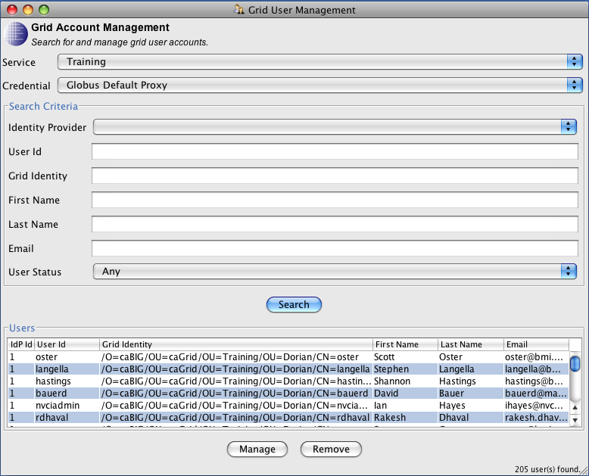
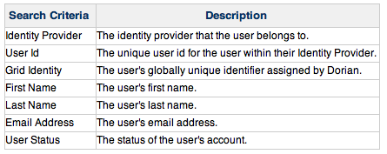
Administrating Grid User Accounts
Managing Grid User Accounts
GAARDS UI
Dorian Client API (Embed into applications)
Account Search
*** Only Dorian Administrators may administrate grid user accounts ***
http://www.cagrid.org/display/dorian13/Grid+User+Search

Slide 71
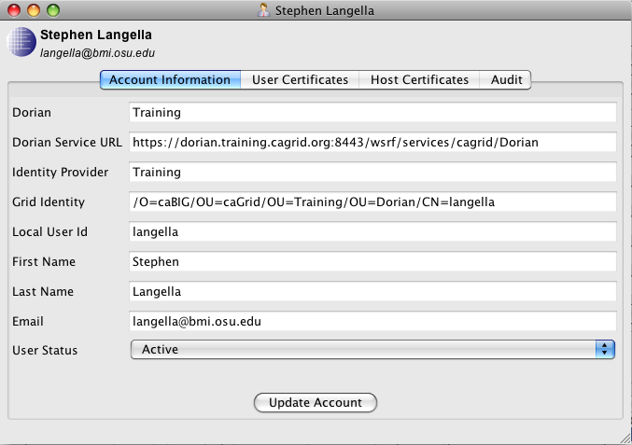
Grid User Account
Grid User Accounts
Account Information – Attributes describing the identity of the user.
User Certificates – Record or each short term certificate issued to the user.
Host Certificate – List of host certificates issued to the user.
Audit – Auditing information for the account
http://www.cagrid.org/display/dorian13/Grid+User+Account+Overview

Slide 72
Grid User Account
Account Information / User Attributes
Grid Identity - globally unique identifier for the user, this identity is used by services and other parties for identifying the user.
Identity Provider - The identity provider in the federation in which the user belongs to.
Local User Id* - The users unique identity within the identity provider they belong to.
First Name* - The user’s first name
Last Name* - The user’s last name
Email Address* - The user’s email address
Account Status – The status of a user's account. (Active, Pending, Suspended, Rejected)
Grid Identity
Dorian CA Subject
Identity Provider Name
Local User Id
/O=OSU/OU=BMI/OU=caGrid/OU=Dorian/OU=localhost/OU=OSU/CN=jdoe
Dorian CA Subject
IdP Name
Local User Id

Slide 73
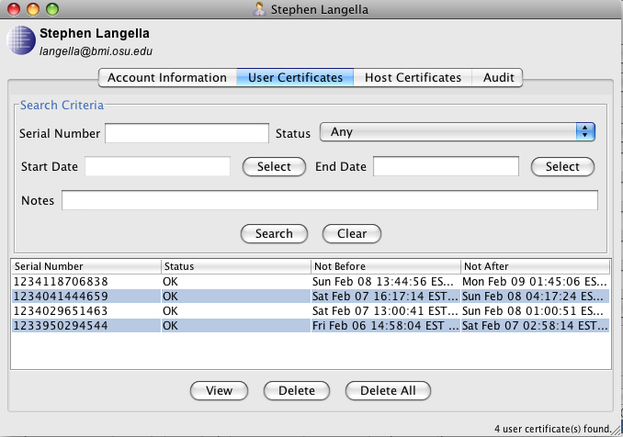
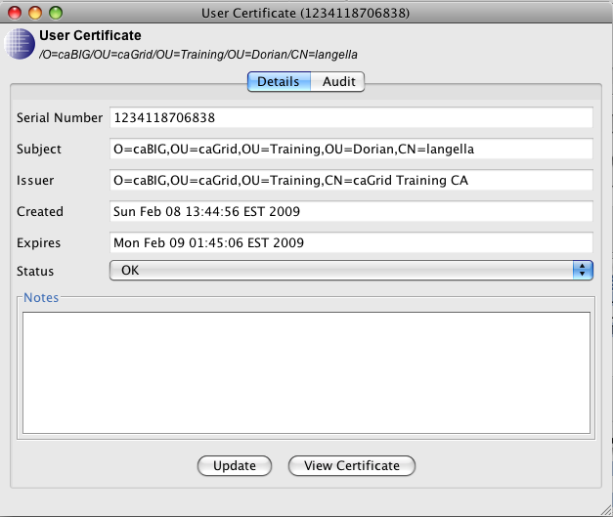
Grid User Account
User Certificates
Dorian maintains a record of all user certificates requested by a user.
Administrators may search for and view all issue user certificates
Administrators may also revoke any issued user certificate.
This control is important for revoking user certificates that were found to be compromised that may have been used for digitally signing.
Searching for User Certificates
Serial Number
Status
Date
Notes – Items documented by administrators concerning the user certificate.

Slide 74
Grid User Account
User Certificates
Dorian maintains a record of all user certificates requested by a user.
Administrators may search for and view all issue user certificates
Administrators may also revoke any issued user certificate.
This control is important for revoking user certificates that were found to be compromised that may have been used for digitally signing.
Searching for User Certificates
Serial Number
Status
Date
Notes – Items documented by administrators concerning the user certificate.

Slide 75
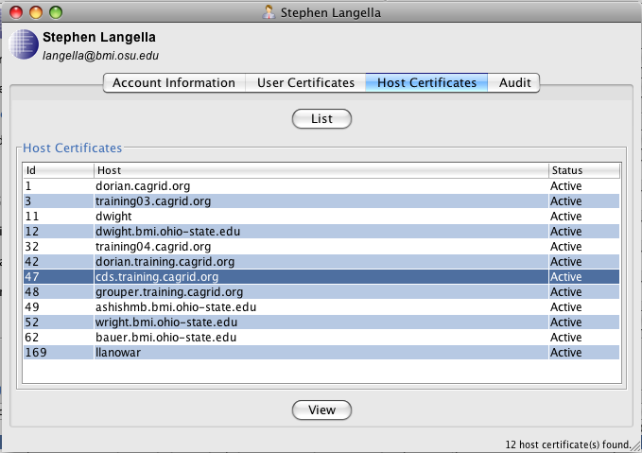
Grid User Account
Host Certificates
Credentials for web/grid services
Dorian will issue host certificates only to users with a valid user account.
Each host certificate is bound to a user.
User assumes responsibility for the host credential.
If a user’s account is Suspended, all of the user’s host certificates are revoked.
Administrators can view/administer the host certificates bound to each users account.

Slide 76
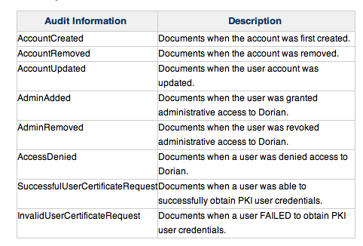
Grid User Account
Auditing – Dorian maintains auditing information on each user account.

Slide 77
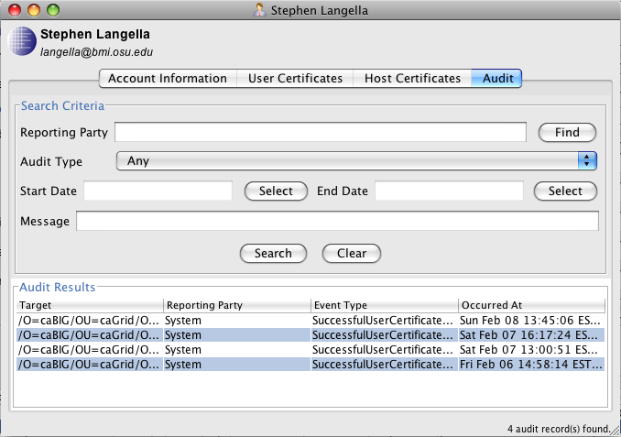
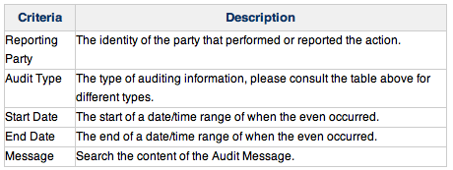
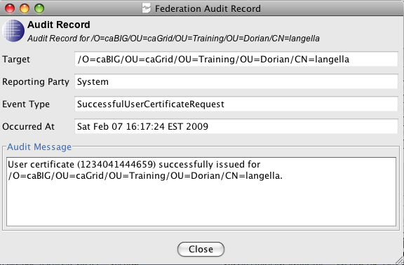
Grid User Account
Audit Record Search

Slide 78
Grid User Account Creation
A grid account is created the first time a user accesses Dorian with a SAML Assertion signed by a registered Trusted Identity Provider
Each grid account has a status associated with it.
Active, Pending, Rejected, Suspended
Only users with an Active Status will be given access to the grid.
The initial status of a user account upon creation depends on the user policy configured with their IdP.
A User Policy is applied to a user’s account every time they request that a proxy is created.
User Policies enable the administration of Dorian to be as hands on/off as the administrators wish.

Slide 79
Host Certificates
Web/Grid services need credentials in order to authenticate themselves with other service or clients.
Dorian provides support for issuing host certificates to be used as credentials for Web/Grid services.
General Guidelines
Dorian will issue host certificates only to users with a valid user accounts.
Each host certificate is bound to a user.
User assumes responsibility for the host credential.
If a user’s account is Suspended, all of the user’s host certificates are revoked.
Dorian will issue one host credential per host name, if that is list that certificate must be revoked before another one is issued.
Dorian can be configured to automatically approve all host certificate requests or require sign of by administrators.
Administrators can view/administer host certificates issued by Dorian

Slide 80
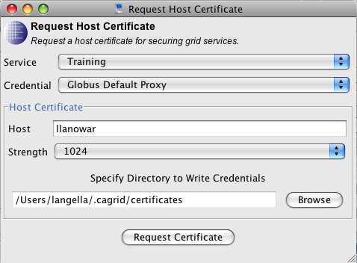
Host Certificates
Requesting Host Certificates
Can be requested using the GAARDS UI or Dorian Client API
User must authenticate with Dorian issued user certificate.
User must provide a Hostname and key length
Requesting a host certificate will generate a private/public key pair locally.
The public key will be sent to Dorian along with the host certificate request.
If auto approval is enabled, a host certificate will be issued and signed using the provided public key.
The host certificate will returned to the user.
The host certificate and locally generated private key, make up the host credential.
The user is responsible for protecting the private key.

Slide 81
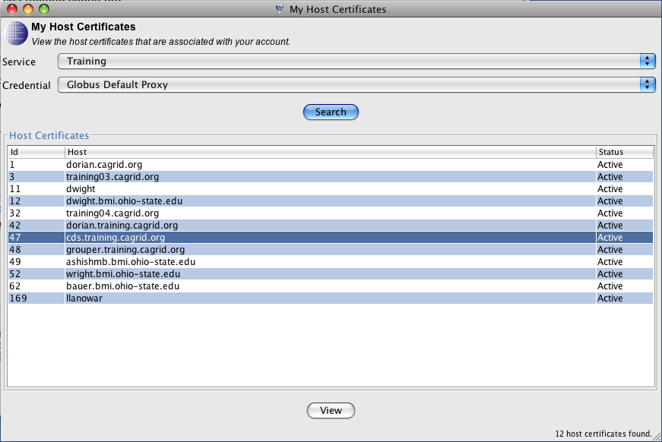
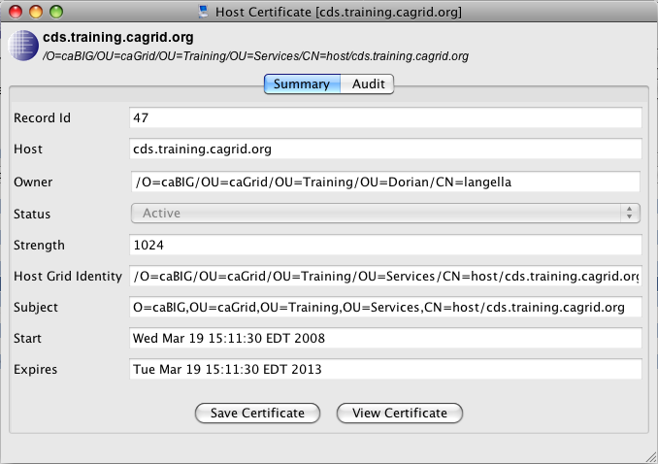
Host Certificates
User may check the status of host certificates they requested or view host certificates issued to them.
Users may download the certificate that were issued to them.
This is important for requests that were not auto approved.
The user should have the private key that was generated when they submitted the request.

Slide 82
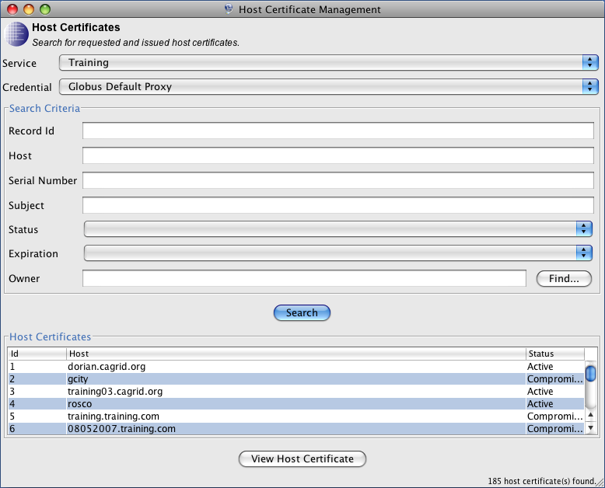
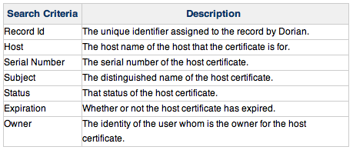
Administering Host Certificates
Dorian administrators may view/manage host certificates requested issued by Dorian.
Browse / Search host certificates

Slide 83
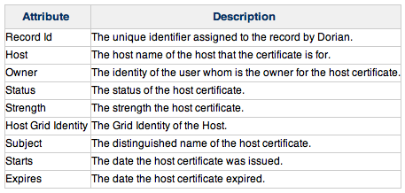
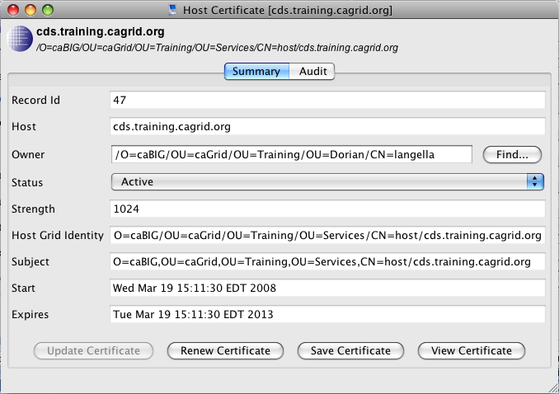
Administering Host Certificates
View / Administer Host Certificates
Core Actions
Update Status
Active
Pending
Rejected
Suspended
Compromised
Change Owner
Renew Certificate

Slide 84
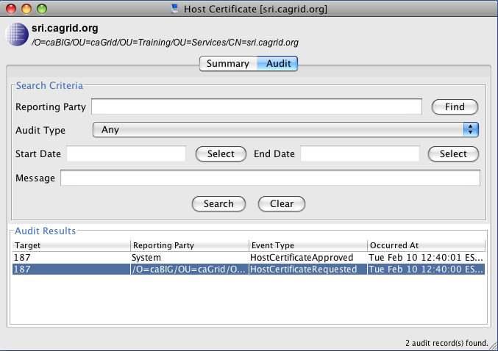
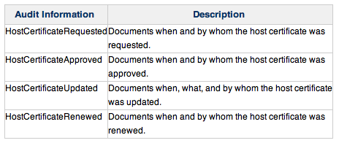
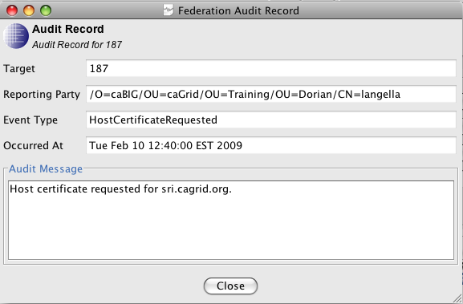
Administering Host Certificates
Auditing – Dorian maintains the following auditing information for host certificates
Audit Record Search

Slide 85
Trusted Identity Providers
Identity Provider (IdP) - Federation partner that vouches for the identity of a user. The Identity Provider authenticates the user, and provides an authentication token to a service provider.
Dorian maintains a list of identity providers that Dorian trusts and will accept credentials from, these identity providers are referred to as trusted identity providers.
User with accounts on trusted identity providers may use their credentials with that identity provider to obtain PKI users and host credentials with Dorian.
Assumptions / Requirements
Identity providers that wish to be trusted must provide and implementation of the Authentication service.
The Authentication Service provides a standard interface for communication will identity providers despite the underlying technology that they leverage.

Slide 86
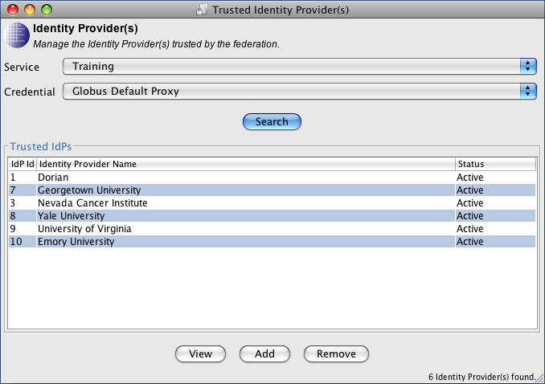
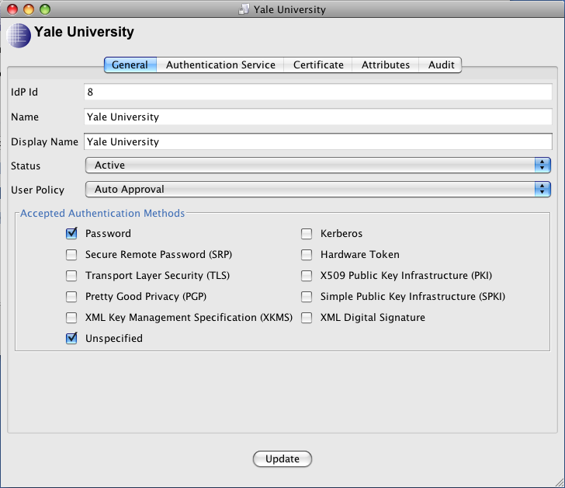
Trusted Identity Providers
Administrators may add, update and manage the list of identity providers trusted by Dorian.
Trusted Identity Provider
General Information – Identity attributes, status, and policies of the identity provider.
Authentication Service – Information regarding the identity provider’s authentication service.
Certificate - The certificate that corresponds to the private key used in signing SAML Assertions issued by the identity provider.
SAML Attributes – The namespace and name of the user identifying attributes provided in SAML assertions issued by the identity provider.
Audit – Auditing information maintained on the identity provider.

Slide 87
Trusted Identity Provider
Core Attributes
Id– Unique Id assigned by Dorian to the identity provider.
Name – Unique name for identifying the identity provider.
Display Name - The display name of the identity provider.
Status – Whether or not the identity provider is Active.
Administrators can temporarily or permanently suspend access to all user from a given identity provider.
User Policy – Specified what happens when users from this identity provider first authenticate with Dorian.
Auto Approval – Users account is immediately created and activated.
Manual Approval – Users account is immediately created however is not activated until approved by an administrator.
Authentication Methods – Specifies which authentication mechanisms are acceptable by Dorian from this identity provider.

Slide 88
Trusted Identity Provider
Authentication Service Attributes – Specify connections details for the identity provider’s Authentication Service.
Authentication Service URL– The URL for the identity provider’s authentication service.
Authentication Service Identity – Unique name for identifying the identity provider.
Certificate – Used to verify digital signature of SAML Assertions issued by Authentication Service/Identity Provider.
This certificate contains the matching public key to the private key used by the Authentication Service/Identity Provider to sign SAML Assertions.
SAML Attributes – Dorian requires that an identity provider specify identifying attributes (user id, first name, last name, email) in the form of SAML attributes in each SAML Assertion.
Dorian is flexible as to how each identity provider represents these attributes in assertions they issue.
This eases integration with identity providers that already are capable of issuing SAML Assertions, enabling Dorian to consume native assertions issued by that identity provider.
To support this flexibility, Dorian must be configured with the expected representation (namespace, name) of these attributes for each identity provider.

Slide 89
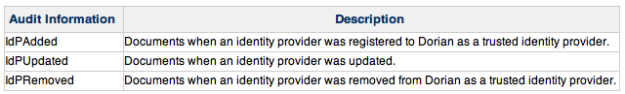
Trusted Identity Provider
Auditing – Dorian maintains the following auditing information for trusted identity providers.
Audit Record Search

Slide 90
Trusted Identity Provider Metadata
Dorian publishes metadata about the identity providers it trusts.
Display Name
Authentication Service URL
Authentication Service Metadata
This allows user interfaces to be built that automatically include new identity providers when they are added.

Slide 91
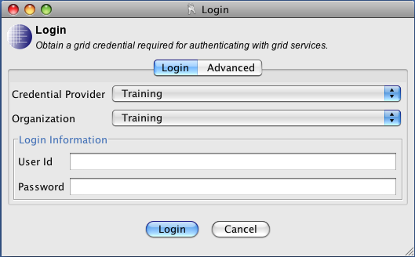

Authentication Service/Dorian Metadata
Credential Provider, contains list of Dorian Services
Authentication Service

Slide 92
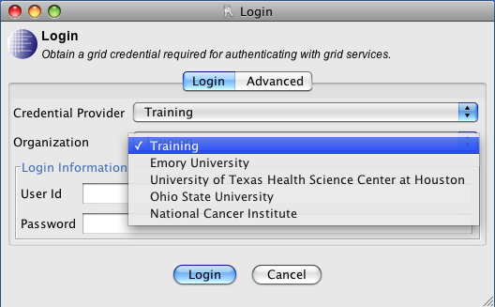
Authentication Service/Dorian Metadata
Selecting a credential provider will determine which identity providers Dorian trusts.
Authentication Service
What Identity Providers do you trust?
Trusted Identity Provider Metadata

Slide 93
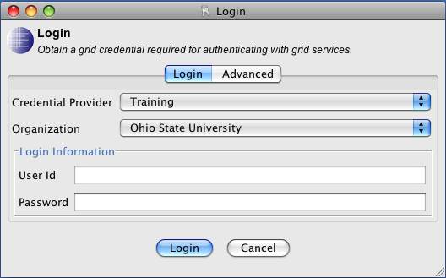
Authentication Service/Dorian Metadata
Selecting an organization/identity provider will then determine the required authentication method.
Authentication Service
How do I authenticate to you?
Authentication Profile(UserId/Password)

Slide 94
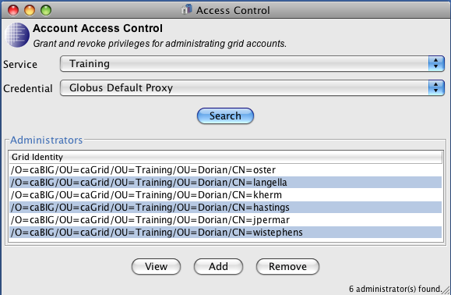
Dorian Administrators
Dorian maintains a list of users that are able to administrate the identity federation components of Dorian.
User in this list are MUST have active accounts with Dorian.
Users in this list CANNOT administer the Dorian Identity Provider, they must be specified as an administrator of that separately.

Slide 95
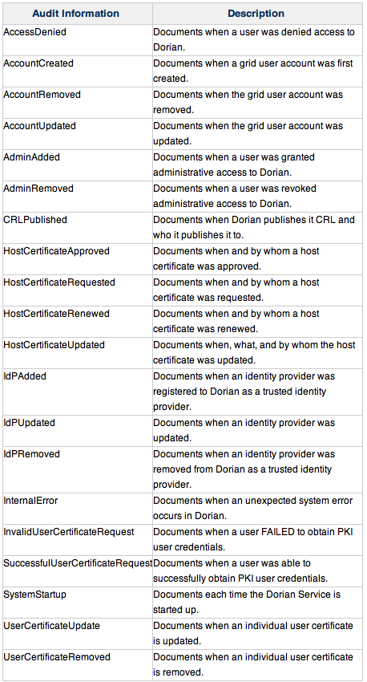
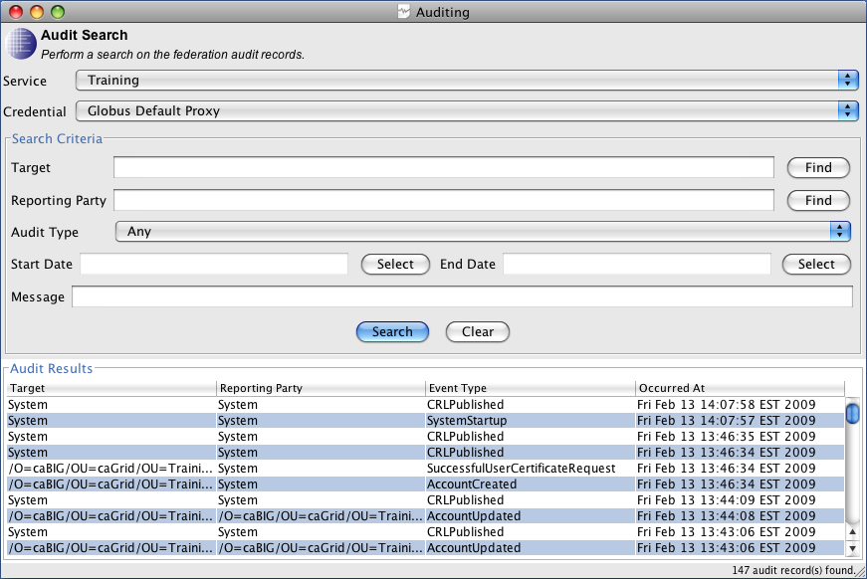
Federation Auditing
Dorian allows administrators to perform and audit across all federation auditing information maintained by the system.

Slide 96
Dorian Identity Provider

Slide 97
Dorian Identity Provider
Supports underserved users in a larger federated environment.
Enables developers, smaller groups, research labs, unaffiliated users, and other groups without an identity provider to use Dorian as their identity provider.
Convenient for small/test environments
Multiple identity providers/federation is not desired
Quickly stand up an account management system with all the benefits of the Dorian federation system.
Implement Authentication Service Interface
Behaves like any other Authentication Service / Identity Provider.
Work seamlessly with all the standard Authentication Service clients.
Federal e-Authentication Compliant
Level 1 and Level 2 Compliant

Slide 98
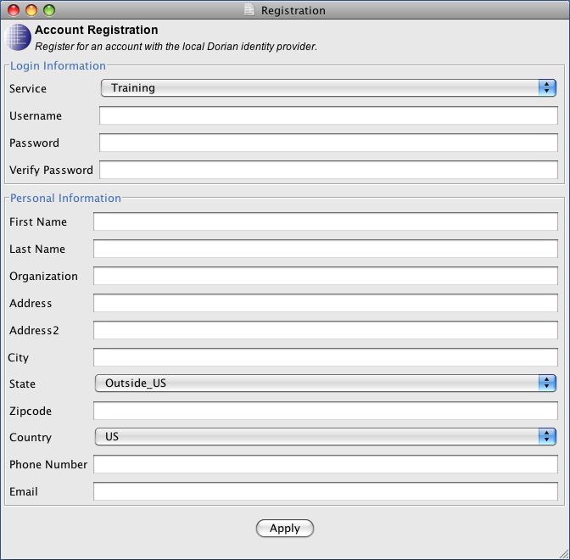
Registration
Potential Users obtain and account on the Dorian IdP by registering.
Grid Service Interface provides a mechanism for registering with the Dorian IdP account.
GAARDS GUI provides graphical interface for registering with the Dorian IdP
Registration can also be done using Dorian Client API
Account creation depends on how the Dorian IdP is configured
Auto Creation
Manual Creation
Once Approved, registered users can authenticate (username, password) to the Dorian IdP to obtain a SAML Assertion which can then be used to create a proxy.

Slide 99
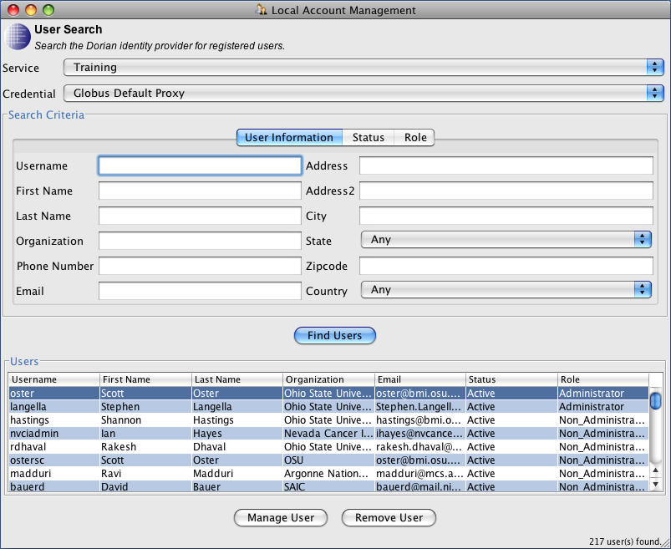
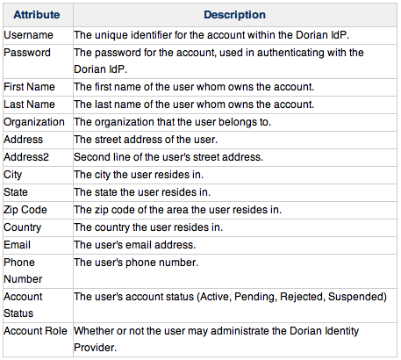
Administrating User Accounts
Administrating Dorian IdP Accounts
GAARDS UI
Dorian Client API (Embed into applications)
Account Search

Slide 100
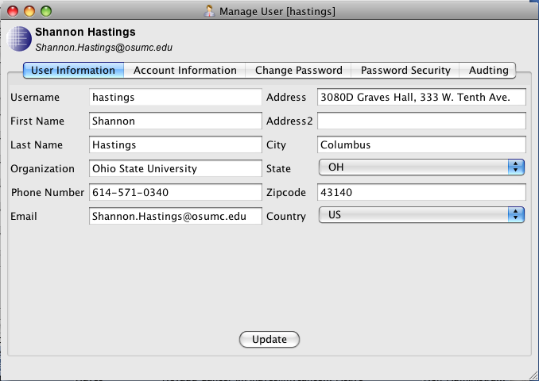
Dorian Identity Provider Account
Dorian Identity Provider Accounts
User Information – Attributes describing the identity of the user.
Account Information– The Account Information tab contains user's Status and Role attributes.
Password– The user’s password and information related to its security.
Auditing – Auditing information for the account

Slide 101
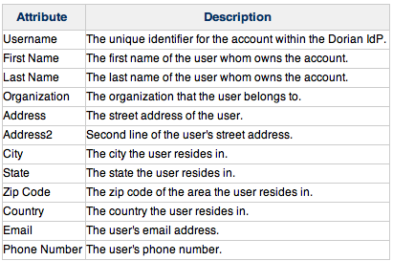
Dorian Identity Provider Account
User Information – Attributes describing the identity of the user.

Slide 102
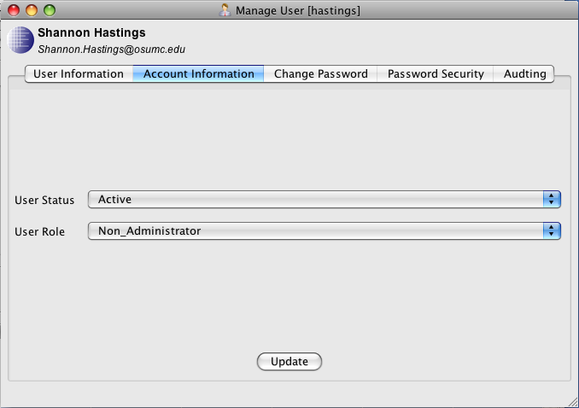
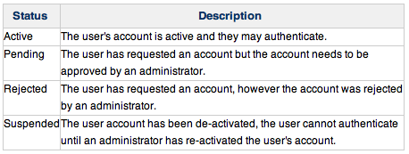

Dorian Identity Provider Account
Account Information – Information describing the role and status of a users account.
User Status – The current status of the users account.
User Role – Whether or not the user can administer the Dorian Identity Provider

Slide 103

Dorian Identity Provider Account
Account Password
Used to authenticate with the Dorian Identity Provider
Federal eAuthentication Level 1 and Level 2 Compliant
Password Strength Requirements
10 – 20 Characters (Configurable)
At Least 1 Capital Letter
At Least 1 Number
At Least 1 non-alphanumeric symbol
No dictionary words (forwards or backwards)
Password Security (Configurable)
5 Invalid consecutive logins, results in a 4 hour suspension of account
500 total invalid logins results in permanent suspension of account until password is reset by and administrator.
Changing Passwords
No requirements for changing passwords
Users may change their own password whenever they desire
Administrator may reset passwords.
Changing a password resets password security.

Slide 104


Dorian Identity Provider Account
Auditing – Dorian maintains auditing information for each Dorian Identity Provider users accounts
Dorian Identity Provider administrator may search/view the auditing information for each account.

Slide 105




Dorian Identity Provider Auditing
Dorian enables Dorian Identity Provider administrators to perform and audit across all the Dorian IdP auditing information.
Audit Search Criteria
Auditing Information

Slide 106
Questions
www.cagrid.org

Slide 107
Grid Trust Service
Stephen Langella
Stephen.Langella@osumc.edu
June 2009
http://www.cagrid.org

Slide 108
How do we know which CAs to Trust?
Should I trust this CA?
Should I trust this CA?

Slide 109
Motivations
Globus Approach (Out of Box)
Service Container and or Service can be configured by specifying a trusted ca certificates directory in the server/service configuration directory
Credentials are accepted if they are signed by a ca certificate in the trusted ca directory.
Drawbacks
Hard for grid administrators to manage
Difficult to provision trusted authorities
Every time a new trusted authority comes on line, all the services in the grid must re-configured to trust that authorities.
Difficult to provision CRLs
Impossible to keep trusted CA list current
Trust is configured at the container level, not at the service level
Trust Fabric in the hands of users
Potential Serious Security Risk

Slide 110
Certificate Validation Profiles
Locally Stored Locally Validated Profile (LSLV)
Trusted Certificates are locally stored.
Revocation Lists Store Locally
Certificates received are validated against locally stored trusted certificates.
Equivalent to XKMS Tier 0
Pros
Almost no infrastructure required
Cons
Impossible to keep trusted CA list current
Trust Fabric in the hands of users
Potential Serious Security Risk

Slide 111
Certificate Validation Profiles
Remotely Retrieved Locally Validated Profile (RRLV)
Trusted Certificates exist and are managed by a Trust Service
Certificates received are validated against trusted certificates retrieved from a trust service
Equivalent to XKMS Tier 1
Pros
Authentication performed against the current trust fabric
Validation done locally, specialized validation requirements can be enforced.
Cons
Validation done locally, poor enforcement could lead to a potential security risk.
Relies on bootstrapping from the Trust Service

Slide 112
Certificate Validation Profiles
Remotely Stored Remotely Validated Profile (RSRV)
Trusted Certificates exist and are managed by a Trust Service
Certificates received are sent to a Trust Service to be validated
Equivalent to XKMS Tier 2
Pros
Authentication performed against the current trust fabric
Validation done remotely and enforced globally.
Local deployment no longer responsible for validation
Certificate Path Discovery Managed.
Enforcement of CA Signing Policies
Cons
Network Overhead

Slide 113
Certificate Validation Profile Support
Locally Stored Locally Validated Profile (LSLV)
Supported by Globus
Directory of Trusted Certificates
Certificate Validation against certificates in directory of Trusted Certificates
Remotely Retrieved Locally Validated Profile (RRLV)
Use trust service to obtain trusted CA certificates and CRLS and store them in the Globus Trusted Certificate directory.
Trust Service client manages the Globus Trusted Certificate directory for Globus, keeping it up to date.
Only minor changes to Globus required.
Supporting Remotely Stored Remotely Validated Profile (RSRV)
Globus contacts Trust Service during authentication to determine if the credentials in question are signed by a Trusted CA
Trust Service performs all validation and enforces revocation lists.
Support requires SIGNIFICANT changes to the Globus Toolkit

Slide 114
Grid Trust Service Approach
Design and Implement a Grid Trust Service
Support for the Remotely Retrieved Locally Validated Profile (RRLV).
Provide plug-in for the existing Globus Toolkit
Supporting the Retrieved Remotely Validated Profile (RRRV)
Work with Globus team to develop a validation interface abstracting validation in Globus.
Future versions of Globus can be configured with a custom validation interface

Slide 115
Grid Trust Service (GTS)
Grid Trust Service (GTS)
WSRF Grid Service
Define and manage levels of assurance.
Provides Support for Managing Trusted Certificate Authorities
Administrator register/manage certificate authorities and CRLS with GTS
Client tools synchronize Globus Trust Framework with GTS
Remotely Retrieved Locally Validated Profile (RRLV)
Globus is authenticating against the current trust fabric
Distributed GTS, Enabling the creation of a scalable trust fabric.

Slide 116


Levels of Assurance
Identity Providers have difference policies under which they issue credentials.
i.e. Passport vs. Library Card
i.e. E-Authentication Level 1 vs Level 2 vs Level 3 vs Level 4
The GTS allows administrator to add/manage levels of assurance that distinguish between different polices
Certificate authorities registered with the GTS can be associated with the levels assurance that they comply with.
Certificate authorities can be discovered by the level(s) of assurance that they meet.
Service providers can trust certificate authorities by level of assurance.
GTS Administrators can Add/Update/Remove Trust Levels

Slide 117


Administrating Certificate Authorities
Administrating Certificate Authorities
GAARDS UI
GTS Client API (Embed into applications)
Certificate Authority Search

Slide 118

Trusted Certificate Authority
Properties – Properties describing the state of the certificate authority
Levels of Assurance– The levels of assurance that the certificate authority complies with.
Certificate– The certificate authority’s certificate.
Certificate Revocation List – The certificate authority’s CRL.

Slide 119
Trusted Certificate Authority
Certificate Authority Properties
Name (Subject of the CA Certificate)
Status – The current status of the CA (Trusted or Suspended)
Is Authority – Specifies whether or not the GTS listing this Trusted Authority is the authority for it.
Authority GTS – The authoritative GTS for the Trusted Authority
Source GTS – The GTS from where the current GTS obtained the Trusted Authority from.
Expiration – The date at which after this Trusted Authority should no longer be trusted.

Slide 120

Trusted Certificate Authority
Levels of Assurance
Certificate authorities registered with the GTS can be associated with the levels assurance that they comply with.
Certificate authorities can be discovered by the level(s) of assurance that they meet.
Service providers can trust certificate authorities by level of assurance.

Slide 121


Trusted Certificate Authority
Certificate
The CA’s X.509 Certificate
Contains the public key which corresponds to the private key used by the CA to sign certificates it issues.
Certificate Revocation List
Contains a list (by serial number) of all the certificates that the CA has been revoked.
With proper permissions, the CRL can be updated through the GTS client API.
Dorian supports updating its CRL in the GTS, when it revokes certificates.

Slide 122
Querying for Trusted Authorities
GTS provides a public mechanism for discovering/querying the Trusted Certificate Authorities.
Query interface enables synchronization tools to be built to synchronize authorities trusted be Globus with those trusted by the GTS
GTS Provides a Java Search Client API
Query Criteria

Slide 123

SyncGTS
Toolkit used for synchronizing client and service containers with the GTS
Takes a set of GTS Queries and executes them on a GTS, synchronizing the results of the queries with the Globus Trusted Certificates Directory.
Supports multiple execution mechanisms.
Grid Service in a grid service container
Embedded in a client or service
Command Line

Slide 124

Federated Trust Fabric
A GTS can inherit Trusted Authorities and Trust Levels from other Grid Trust Services
Allows one to build a scalable Trust Fabric.
Allows institutions to stand up their own GTS, inheriting all the trusted authorities in the wider grid, yet being to add their own authorities that might not yet be trusted by the wider grid.
A GTS can also be used to join the trust fabrics of two or more grids.

Slide 125


Federated Trust Fabric
Each GTS has a set of Authoritative GTSs
The GTS can be configured how often to sync with its authorities.
On syncing a GTS will obtain all valid Trusted Authorities and Levels of Assurance (if specified) from each authority GTS and organize them locally base on priority.
Managing GTS Authorities for a GTS
GTS provides support for adding/updating /removing GTS Authorities through its Grid Service Interface.
Requires Grid Credentials or Proxy Certificate of a GTS Administrator
GTS Provides an administrative Java Client
GTS Provides an administrative GUI.

Slide 126


GTS Administrators
The GTS maintains a list of users that are able to administrate the GTS.
The GTS allows two types of permissions
GTS Administrator – Can administer all aspect of the GTS
Trusted CA Administrators – Can publish the CRL for a specified CA.

Slide 127
Questions
www.cagrid.org

Slide 128
Grid Grouper
Stephen Langella
Stephen.Langella@osumc.edu
June 2009
http://www.cagrid.org

Slide 129
Grid Grouper
Grid Grouper provides a group based authorization solution for the grid.
Groups are defined and managed at the grid level.
Grid services/applications enforce authorization policy based on membership to groups.
Grid Grouper is built on top of Grouper.
Grouper
Internet 2 Initiative (http://middleware.internet2.edu/dir/groups/grouper/)
Java Object Model for Group Management
Basic group management by distributed authorities
Construction of group based on subgroups
Composite groups (whose membership is determined by the union, intersection, or relative complement of two other groups);
Custom group types and custom attributes;
Trace back of indirect membership
Applications interact with Grouper by embedding the Grouper’s java object model within applications.

Slide 130

Grid Grouper
Grid Grouper Grid enables Grouper
WSRF Compliant Web Service
Enables Grid access to Groups
Allows management of Groups from the Grid
Grid Grouper Object Model
Java API for accessing and managing groups over the grid.
Similar to Grouper’s Object Model
Applications/Service leverage Grid Grouper Object model in a similar fashion to leveraging the Grouper Object Model.
Grid Grouper Admin UI
Graphical User Interface for accessing and administrating groups in Grid Grouper.

Slide 131

Stems
Groups are organized into Stems or Namespaces for partitioning Groups.
Stems are organized into hierarchies.
Stem
Details - Information describing the stem
Child Stems - Child stems or namespaces of the stem.
Groups - The Groups that are part of the stem.
Privileges - The permissions or privileges granted to parties for governing the stem.

Slide 132

Stems
Stem Details

Slide 133


Stems
Stem Privileges
Stem - Give users the right to create, modify, and remove child stems.
Create - Gives the users the right to create, and remove child groups.

Slide 134

Stems
Child Stems
Each stem in Grid Grouper may have any number of child stems
Users with the stem privilege on the current stem may create child stems.
Groups
Each stem in Grid Grouper with the exception of the root stem may contain any number of groups
Users with the Create privilege on the stem may create groups.

Slide 135


Groups
Group
Details – Information describing the group.
Members – A set of user or groups that are members of the group.
Privileges - Set of subjects that have rights to access the group
Group Details

Slide 136



Group Memberships
Direct Membership
User is directly added as a member to a group
Referred to as an Immediate Member.
Subgroup Membership
A Group can be added to another Group as a subgroup, making all members of the subgroup members of the group.
Members who membership is acquired through a sub group are referred to as Effective Members.
Composite Membership
A group who's members are determined by a set operation (union, intersection, complement) of two other groups.
Example: A composite group consisting of the Intersection of Group X and Group Y would contain all the members that are both member of Group X and Group Y.

Slide 137

Group Members
Members can be added to group by the three supported membership types
Direct Membership (Immediate)
Subgroup Membership (Effective)
Composite Membership
Administrators can view all members of a group or by membership type

Slide 138


Group Privileges
VIEW - Access to a group’s name in lists & can refer to group
READ – Access basic information about a group
UPDATE – Administer membership and membership related privileges
ADMIN - Can modify everything, including group name, description, & privileges, and can delete the group
OPTIN - Can add self to the members list
OPTOUT - Can remove self from the members list

Slide 139

Introduce
Introduce
A graphical framework which enables fast and easy creation of Globus based grid services.
Introduce and Grid Grouper
Support for protecting access to grid services with Grid Grouper
Service Level
Method Level

Slide 140
Questions
www.cagrid.org

Slide 141
Common Security Module (CSM)
Vijay Parmar
parmarv@mail.nih.gov
Ekagra Software Technologies

Slide 142
Agenda
Introduction
CSM Overall Architecture
Authentication Service
Authorization Service
Concepts
Service Types
Sample code
User Provisioning Tool
Overview
Screen shots
Installation and Deployment

Slide 143
Common Security Module v4.1
Open Source Technology – based on standard NCI CBIIT Technology Stack, Java Authentication and Authorization Service (JAAS) based.
Authentication Service
Authentication of User Credentials against credential providers
Currently supports RDBMS and LDAP/LDAPS based credential providers for authentication
Authorization Service
User based, Role/Group based, Attribute level &/or Instance level security
Provision User security policy and check permission services
CSM API (v4.1)
Minor coding required to integrate the API services
Easy integration into existing applications, available as jar file.
User Provisioning Tool (v4.1)
Management of user’s authorization policy via easy to use Web-based UI.
CSM – GAARDS Migration Module (CGMM v0.6)
A solution to migrate existing (web or services) applications from CSM based authentication to use caGrid GAARDS based authentication.

Slide 144


CSM - High Level Architecture
Application server
UPT Web Interface
Application XYZ
Authenticate
Application Server
JAAS
User Provisioning application
Authorize
Common Security module
Authenticate
Authorize
Authorize
Credential Providers
CSM Authorization Schema
RDBMS
LDAP

Slide 145
CSM - High Level Architecture
Application server
UPT Web Interface
Application XYZ
Authenticate
Application Server
Authorize
User Provisioning application
JAAS
Common Security module
Authenticate
Authorize
Authorize
Application Admin uses UPT to manage Authorization Policy
Credential Providers
CSM Authorization Schema
RDBMS
LDAP

Slide 146
CSM - High Level Architecture
Application server
UPT Web Interface
Application XYZ
Authenticate
Application Server
JAAS
User Provisioning application
Authorize
Common Security module
Authenticate
Authorize
Authorize
Authorization Policy stored in CSM Authorization Schema
Credential Providers
CSM Authorization Schema
RDBMS
LDAP

Slide 147
CSM - High Level Architecture
Application server
UPT Web Interface
Application XYZ
Authenticate
Application Server
JAAS
User Provisioning application
Authorize
Common Security module
Authenticate
Authorize
Authorize
Application invokes CSM API with User Credentials
Credential Providers
CSM Authorization Schema
RDBMS
LDAP

Slide 148
CSM - High Level Architecture
Application server
UPT Web Interface
Application XYZ
Authenticate
Application Server
JAAS
User Provisioning application
Authorize
Common Security module
Authenticate
Authorize
Authorize
CSM validates User Credential against Credential Provider(s)
Credential Providers
CSM Authorization Schema
RDBMS
LDAP

Slide 149
CSM - High Level Architecture
Application server
UPT Web Interface
Application XYZ
Authenticate
Application Server
JAAS
User Provisioning application
Authorize
Common Security module
Authenticate
Authorize
Authorize
Application invokes CSM API to authorize User
Credential Providers
CSM Authorization Schema
RDBMS
LDAP

Slide 150
CSM - High Level Architecture
Application server
UPT Web Interface
Application XYZ
Authenticate
Application Server
JAAS
User Provisioning application
Authorize
Common Security module
Authenticate
Authorize
Authorize
CSM checks User Permission against the Authorization Policy
Credential Providers
CSM Authorization Schema
RDBMS
LDAP

Slide 151
Authentication Service
Verify user credentials against configured credential providers
JAAS based service
Supports RDBMS and LDAP/LDAPS based credential providers for authentication
Also supports NCI e-directory

Slide 152
NCI’s EDIRECTORY
VERIFY CREDENTIALS
CSM API AUTHENTICATION MODULE
CSM’s
JAAS BASED LDAP LOGINMODULE
JAAS’s LOGIN CONFIG
OTHER LDAP
SERVER
LOGIN MODULE CONFIGURATION
LOGIN RESPONSE
INVOKE PASSING USER CREDENTIALS
VERIFY CREDENTIALS
CLIENT APPLICATION
USER CREDENTIALS
AUTHENTICATION MANAGER
INVOKE
JAAS LOGINCONTEXT
LOGIN RESPONSE
LOGIN RESPONSE
INVOKE PASSING USER CREDENTIALS
USER CREDENTIALS
CALLBACK
LOGIN RESPONSE
USER CREDENTIALS
CSM’s CALLBACK HANDLER
CSM’s
JAAS BASED RDBMS LOGINMODULE
DATABASE
VERIFY CREDENTIALS
Based on the LoginModule, the credentials are verified against the credential providers (LDAP or Database)
The response from the LoginModules is returned to the LoginContext
This response is provided back the AuthenticationManager by the LoginContext
Authentication Manager returns the response back to the Client Application. In case of any exceptions or failure of credentials an appropriate CSException is thrown
Pass the User credential to Authentication Manager
Authentication Manager Constructs a CallbackHandler
Authentication Manager invokes JAAS LoginContext
LoginContext reads the LoginModule info.
LoginContext invokes the appropriate configured LoginModule

Slide 153
Authorization Service
What is Authorization
Check if User has permission to access a resource
Services included as part of authorization
User Provisioning
Create Users, Protection Elements etc..
Associate Users, Protection Elements, Roles..
Check Permission
Instance Level Security provisioning and filtering

Slide 154












Authorization Service – Concepts
Entities
Application
User
Group
Protection Element
Protection Group
Role
Privilege
User Provisioning Workflow
Notes:
Feedback: - Add Description or Diagram to relate Privilege, Roles, Users, PG, PE etc.

Slide 155
Authorization Service – Security Types
User Based Security
Role/Group Based Security
Object Level Security
Attribute Level Security
Instance Level Security
Notes:
Kalpesh

Slide 156
Authorization Service – Sample Code
API level access to perform Authorization operations
AuthorizationManager authorizationManager = SecurityServiceProvider.getUserProvisioningManager("security");
Example: Provisioning Authorization Policy
ProtectionElement tempProtectionElement = new ProtectionElement();
authorizationManager.createProtectionElement(tempProtectionElement);
Example: Enforce Authorization Policy
authorizationManager.checkPermission(…)

Slide 157
User Provisioning Tool (UPT)
The User Provisioning Tool provides a graphical user interface to create authorization data and provision the user security based on the data.
The UPT functions in two modes
Super Admin Mode – To register Applications and Admins
Admin Mode – To administer a registered application’s user authorization policy.

Slide 158

User Provisioning Tool – Super Admin

Slide 159

User Provisioning Tool – Admin Screen

Slide 160
Installation and Deployment
UPT was developed as a flexible application that can be deployed in multiple ways depending on the need or scenario. The three primary modes to install the UPT include the following:
Single Installation, Single Schema
Single Installation, Multiple Schemas
Local installation, Local schema

Slide 161
Single Installation, Single Schema
One Instance of UPT hosted on common application server.
One installation used to administer authorization data for all applications.
Therefore an application using UPT does not have to install its own authorization schema.
App 1
UPT
Ap
p 2
Common
Authorization
Database

Slide 162
Single Installation, Multiple Schema
One Instance of UPT hosted on common application server.
One installation used to administer authorization data for all applications.
An application can use its own authorization schema.
App 1
UPT
Authorization database for App 1
Common Authorization
Database
Authorization database for App 2
App 3
App 2

Slide 163
Local Installation, Local Schema
UPT is not shared with other applications.
This installation is used to administer authorization data for particular applications ( or set of related applications)
UPT
App 1
Authorization
Database

Slide 164
Documentation
CSM Guide for application developers
Multiple deployment models
Configuration & Integration for Authentication
Configuration & Integration for Authorization
Authorization Meta data set up using User Provisioning Tool web interface
UPT user guide
CSM – caGrid Integration

Slide 165
Questions
www.cagrid.org

Slide 166
CSM GAARDS Migration Module
Vijay Parmar
parmarv@mail.nih.gov
Ekagra Software Technologies

Slide 167
Agenda
Introduction
Requirements
CGMM Components and Overall Architecture
CGMM Workflows
CGMM User Interface
Documentation. Questions?

Slide 168
Introduction
Common Security Module (CSM)
provides Application security tools that address authentication, authorization and user provisioning.
Grid Authentication and Authorization with Reliably Distributed Services (GAARDS)
provides services and tools for administration and enforcement of security policy in an enterprise Grid.
CGMM
A web application tool which allows automated and user-oriented process of migrating CSM user ID to GAARDS user ID and allow an application to use GAARDS based authentication.
Notes:
Common Security Module (CSM) provides Application security tools that address authentication, authorization and user provisioning.
Grid Authentication and Authorization with Reliably Distributed Services (GAARDS) provides services and tools for administration and enforcement of security policy in an enterprise Grid.
CSM GAARDS Migration Module is a web application tool which allows automated and user-oriented process of migrating CSM user’s to GAARDS user’s and allow an application to use GAARDS based authentication.

Slide 169
Requirements
Single Set of Credentials
Migrate CSM based local account to caGrid account.
GAARDS based authentication
Notes:
Single Set of Credentials
The existing web applications having CSM based authentication is required to provide Grid based authentication. Hence users with CSM credentials as well as Grid credentials can access all components of existing web application.
The requirement is to avoid duplication of accounts for existing and new users. The application needs to provide a single set of credentials to access various above mentioned components.
GAARDS based authentication
The requirement is to switch CSM based authentication to caGrid’s GAARDS based authentication. Users should not be allowed to login using CSM credentials once they are migrated.
Migrate Accounts
The Migration module will enable migrating of existing users accounts from CSM accounts to Grid accounts. This will make users authenticated against GAARDS for scalability and federation.
Provisioning of new users with Grid Identities.
New users should be allowed to create Grid accounts and login to existing application using Grid credentials. The existing applications Authorization policy provisioning should be enhanced to allow users Grid Identities instead of CSM credentials.
To use caBIG approved Identity Providers and thus allowing federation of identity
The web application should use a caBIG approved Identity Provider as your credential source. This way any user which is member of those Identity Providers can log onto the application (provided the user has appropriate access permission if any).

Slide 170
CGMM Components
Host Application
CGMM Filter (Optional)
caGrid Form Authenticator (Optional)
CGMM
CGMM Web Application
CGMM API
caGrid 1.2 services used by CGMM
Authentication Service
Dorian
SyncGTS
Notes:
The following are the minimum set of components involved in the Migration Module Framework. The following section describes the design for CSM GAARDS Migration Module and integration with Host applications.
CGMM Filter
A new HTTP filter (provided as part of the CGMM) is configured to intercept and forward the user requests to the CGMM to either migrate the user account or to login the user into the Host application. Depending on whether the user is an existing application user or not, the control is passed back either to the login workflow or the new user creation workflow respectively.
CSM – GAARDS Migration Module web application (CGMM)
To assist in the migration of local CSM accounts to caGrid, CGMM is provided. CGMM is a separate web application that resides in the same container as the Host web application. CGMM also provides the Servlet Filter that is placed in front of the Host application intercepting and routing each user request for login or migration purpose. Detailed work flow of the migration module and the considered scenarios are provided in the next section.
Authentication Service
The IdPs registered on NCICB Production Grid will be used as the Identity Provider to validate user’s credentials. They will authenticate the user and provide a SAML token
Dorian
The NCICB Production Dorian is used as a Federation Service to generate user’s grid identity. This Dorian instance will also host all the users migrated from individual local host application instances which are not associated to any other IdPs.
SyncGTS
Sync GTS will be installed in CGMM for the Host application. Sync GTS daemon will keep the Host application in sync with the Grid Trust Fabric and update the CRL’s accordingly. Once the CGMM obtains Grid proxy from Dorian it will validate the proxy against the GTS to make sure the certificate is still valid and has not been revoked.

Slide 171

Host Application
Requested Flow
New User Flow
User Info + Grid Proxy
User Request
CGMM Filter
Pass control
User Info + Grid Proxy
Client
Perform Login
Pass control
CSM LOGIN
GRID LOGIN
CGMM Manager
CSM Login Screen
CSM 4.1 Schema
Validate CSM Credentials
Authentication or Migrate
Grid Login Screen
Authentication Grid User
Authentication Service
Validate Grid Credentials
Create New Dorian User account
Dorian
New Grid User
Screen
Create New Grid User
CGMM Web Tool
Validate Proxy
Web Server
SyncGTS

Slide 172
CGMM Web – Behaviors/Modes
Default Behavior
Original workflows/scenarios as described in following slides.
Alternate Behavior
The user must have a Local (CSM) account.
The user may or may not have a caGrid Account.
The Application wishes to leverage caGrid authentication and account migration features only.
Based on those criteria there are two different scenarios addressed by the CGMM Tool. The scenarios are as follows
1. User logs in with CSM account and user has a caGrid account
2. User logs in with CSM account and user does not have a caGrid account

Slide 173
CGMM Workflows – Default Behavior
The CGMM Tool allows multiple scenarios/workflows based on the User. The user may or may not have CSM account. The user also may or may not have a caGrid Account.
Based on the above there are four different scenarios addressed by the CGMM Tool. The scenarios in default behavior/mode are as following:
User logs in with CSM account
User does not have a caGrid account.
User has a caGrid account
User logs in with caGrid account
User does not have a CSM account
User has a CSM account.
Note: The CGMM tool DOES NOT address the scenario where a User does not have a CSM (local) Account and does not have a caGrid account as well. The host application needs to address this scenario.

Slide 174

UI – CGMM Home Page

Slide 175

GAARDS Login Page
User is already authenticated with valid CSM login ID and password.

Slide 176

Migration Confirmation Page
- User is already authenticated with valid CSM login ID and password.
User is also authenticated with valid GAARDS (caGrid) based Login ID,
Password against Authentication Source (service).

Slide 177

Migration Success page

Slide 178

Host application page

Slide 179

New Grid account page

Slide 180

New Grid account confirm page

Slide 181
Technical Environment
CSM V4.1 / CSM UPT v4.1
caGrid Release v1.2

Slide 182
Documentation/More info
CSM GAARDS Migration Module Guide
http://gforge.nci.nih.gov/docman/view.php/12/15148/CSM41_GAARDSMigrationModuleGuide.pdf
CSM
http://ncicb.nci.nih.gov/NCICB/infrastructure/cacore_overview/csm
GAARDS
http://www.cagrid.org/wiki/GAARDS:Main

Slide 183
Questions
www.cagrid.org

Slide 184
Credential Delegation Service
Stephen Langella
Stephen.Langella@osumc.edu
June 2009
http://www.cagrid.org

Slide 185
Delegation
PKI Review
A PKI Credential consists of a certificate and private key.
Private key is kept “safe” and is used for proving ownership of the certificate (public information).
Federated Query Usecase
How would a federated query service, query other data services on a user’s behalf when it does not have the user’s private key?
Data
Service
Federated
Query
Service
Data
Service

Slide 186
Delegation
Proxy Certificates
Allow users to delegate on the fly by granting other entities the right to use their name
Standardized in IETF/PKIX 2004
Fully implemented, deployed and widely used
Same format as X.509 Public Key Identify Certificate, but signed by user (or another proxy certificate)
Name scoped to issuer’s name
Support restricted delegation from issuer to bearer
Includes critical extension to identify as Proxy and express delegation

Slide 187
Identity Certificate vs Proxy Certificates
Certificate attribute | X.509 Public key certificate | X.509 Proxy Certificates
Issuer/ Signer | A certification authority | A public key certificate or another Proxy Certificate
Name | Any as allowed by issuer’s policy | Unique, scoped to namespace defined by issuer’s name
Delegation from Issuer | None | Allows for arbitrary delegation policies
Key pairs | Uses unique key pair | Uses unique key pair

Slide 188
Delegation, the BIG Picture

Slide 189
Credential Delegation Service (CDS)
Credential Delegation Service (CDS) - A SOAP-based Web service that enables users/services (delegator) to delegate their Grid credentials to other users/services (delegatee) such that the delegatee(s) may act on the delegator's behalf.

Slide 190


Delegating a Credential
Delegation Service
URI of the CDS to delegate to.
Credential
The credential to delegate.
Delegation Lifetime
The amount of time the CDS may delegate the credential for.
Delegated Credential Path Length
The path length of the credential issued to the CDS.
Issued Credential Lifetime
The lifetime of credentials issued by the CDS to permitted clients.
Issued Credential Path Length
The path length of credentials issued by the CDS to permitted clients.
Delegation Policy
Policy specifying which client may request a delegate credential.

Slide 191
Delegation Policy
Delegation Policy – Allows a client to express to the CDS which entities may obtain their credential.
The CDS was architected to allow Delegation Policies to be plugged in.
Developers may easily implement and integrate their own Delegation polices.
Delegation Policies
Identity Delegation Policy – A list of grid identities each whom are allowed to request a delegated credential.
Group Delegation Policy – Allows members of a specified Grid Grouper Group to request a delegated credential

Slide 192

Delegating a Credential
Delegating a Credential

Slide 193
Delegating a Credential
Delegating a Credential

Slide 194
Delegating a Credential
Delegating a Credential

Slide 195
Delegating a Credential
Delegating a Credential

Slide 196
Delegating a Credential
Delegating a Credential

Slide 197

Obtaining a Delegated Credential
Delegated Credential Reference
Reference to the credential that the client wishes to obtain
Credential
The client’s credential, used to authenticate with the CDS and obtain the desired delegated credential.

Slide 198
Obtaining a Delegated Credential
Obtaining a Delegated a Credential

Slide 199

Obtaining a Delegated Credential
Obtaining a Delegated a Credential

Slide 200
Obtaining a Delegated Credential
Obtaining a Delegated a Credential

Slide 201
Obtaining a Delegated Credential
Obtaining a Delegated a Credential

Slide 202
Obtaining a Delegated Credential
Obtaining a Delegated a Credential

Slide 203


Administrating Delegated Credentials
The CDS allows users and administrators to monitor delegated credentials
Users may monitor only the credentials they delegated
CDS administrators may monitor any delegated credentials.
Search Criteria

Slide 204


Administrating Delegated Credentials
General Information – The CDS maintains identifying information for each delegated credential.

Slide 205


Administrating Delegated Credentials
Delegation Policy– The policy under which the credential can be delegated.
Certificate Chain – The signing chain of X.509 certificates and X.509 certificate of the delegated credential.

Slide 206




Monitoring Delegated Credentials
The CDS captures auditing information for delegated credentials
The CDS allows clients to search and access the auditing information

Slide 207

Administering the CDS
The CDS maintains a list of administrator(s).
CDS administrators may monitor all delegated credentials.
CDS administrators can be managed (added, removed) through the CDS web service interface.

Slide 208
Questions
www.cagrid.org

Slide 209
Web Single Sign On
Santhosh K Garmilla
garmillas@mail.nih.gov
Ekagra Software Technologies
June 2009
http://www.cagrid.org

Slide 210
Agenda
SSO Overview and Need for WebSSO
WebSSO Architecture and Components
Work Flow for Single Sign-On and Sign-Out
Installation of WebSSO Components

Slide 211
Definitions
Authentication - The act of confirming that the user is authentic i.e. validating credentials
Login - The process by which an individual accesses a system by authentication
Single Sign-On (SSO) – SSO is a mechanism whereby a single action of user authentication can permit a user to access multiple applications where he has access permission, without the need to enter multiple passwords

Slide 212
SSO OVERVIEW

Slide 213
Access Without SSO
Application
1
Authentication Service (LDAP)
login
access
Application
2
Authentication Service (RDBMS)
login
User/ Browser
login
Application
3
Authentication Service
(e-Directory)

Slide 214

Basic SSO
SSO Server
Authentication Service (LDAP)
login redirect
Application
1
SSO
Managed
domain
login
Application
2
access
User/ Browser
access
Application
3

Slide 215
Web based SSO Discussion
Advantages:
Centralized authentication policy
Users are not required to maintain accounts on individual systems
Users are not required to login into individual systems
Disadvantages:
Supports only web browser based applications

Slide 216
Need for WebSSO
Support Single Sign-on for web applications deployed in multiple domains that need to access caGrid services
Web
Application 1
Grid
Resource 1
WebSSO
Managed
domain
Grid
Resource 2
Web
Application 2
User/ Browser
Grid
Resource 3

Slide 217
WEBSSO ARCHITECTURE AND COMPONENTS

Slide 218
Frameworks and Services Used
Central Authentication Service (CAS) – To manage cookies
caGrid Dorian and Authentication Service - To authenticate user credentials in the caGrid environment
caGrid Credential Delegation Service (CDS) - To delegate the Globus Credentials to other services
caGrid SyncGTS - To enable trust store among all the services

Slide 219
CAS – How It Works
Cache
TGT – ST1
ST2
WebApp
7. User Attributes
3. Validate user & add to registry
2. S (redirect)
User/ Browser
CAS Client
(Acegi Filters)
CAS
Server
4. ST, TGT
1. Request
5. Validate ST , S
6. User Attributes
https://webssoserver/websso/?service=http://webappserver/webapp/protected
http://webappserver/webapp/protected?ticket=ST-1234-cvbfgl
http://webappserver/webapp/protected
https:// casserver/cas/servicevalidate?ticket=ST-1234-cvbfgl &
service =http://webappserver/webapp/protected
TGT will be generated by the CAS server per each browser session when the user is authenticated
TGT will be added to an HTTP cookie upon the establishment of single sign-on and will be checked further when different applications are accessed
Since the cookie is SSL-vended, the Adversary cannot obtain it by eavesdropping on the line
ST will be generated by the CAS server per target web application when the user is authenticated
Expired by the CAS server when logout action is performed or service ticket timeout
S – Service URL
ST – Service Ticket
TGT – Ticket Granting Ticket

Slide 220
Grid Components – Authentication Workflow
The Authentication Service enables existing identity
providers to be seamlessly integrated into a production
Grid environment such that users that are registered with an identity provider may use their existing credentials to access resources on the Grid.
GTS
Sync Trust store
Authentication Service
1. User Credentials
2. SAML
Grid Client Application
Dorian Service
Dorian provides a secure
mechanism to issue and
provision credentials
for Web/Grid services.
3. SAML
4. Grid Credential
5. Delegate grid Credential
CDS

Slide 221
Grid Components – Credential Delegation Service
Client Application
3. Delegation EPR + execute work flow
1. Delegate
user credential
2. Delegation EPR
Grid Service
4. Delegation EPR
CDS
5. Issue user credential
6. Delegation EPR
7. Delegation EPR
Grid Service2
8. Issue user credential
The Credential Delegation Service (CDS) is a WSRF-compliant
Grid service that enables users/services (delegator) to delegate their
Grid credentials to other users/services (delegatee)such that the
delegatee(s) may act on the delegator's behalf.

Slide 222
Establish the SSO Session Workflow
CLIENT
WEB
GRID
1. User Request
WebSSO
Client
Grid Service A
Target
WebApp
15. User Attribute
+ Grid Proxy
16. Grid Proxy
11. ValidateSingle Sign
On Ticket
14. Grid Proxy
Delegation Service
13. Delegation EPR
9. Delegation
EPR
8. Delegation Policy (Grid Proxy)
12. User
Attributes
Assertion
10. Single Sign
On Ticket
6. Grid Proxy
Dorian
WebSSO Server
5. SAML
2. Credentials
4. SAML
Authentication Service
7. Validate
3. Credentials
Trust Store
GTS
Sync trust store

Slide 223
Establish the SSO Session Workflow
CLIENT
WEB
GRID
1. User Request
WebSSO
Client2
Grid Service B
Target
WebApp2
6. User Attribute
+ Grid Proxy
7. Grid Proxy
5. Grid Proxy
Delegation Service
2. Retrieve TGC from
browser and validate
4. Delegation EPR
3. User
Attributes
Assertion
Dorian
WebSSO Server
Authentication Service
Trust Store
GTS
Sync trust store

Slide 224
State of WebSSO Single Sign-On
CLIENT
WEB
WA1-ST1
GRID
WA1-SESSION
Browser Cookie TGC
WebSSO
Client - 1
Target
WebApp -1
/O=caBIG/OU=caGrid/OU=NCICB DEV LOA1/OU=Dorian/CN=User
TGT –
WA1-ST1
WA2-ST2
WebSSO Server
Delegation
Service
WA2-ST2
WA2-SESSION
WebSSO
Client-2
Target
WebApp - 2
.
.
.
.
.
.
WebSSO
Client-n
Target
WebApp - n

Slide 225
Login Complete
WebSSO Client retrieves and sets following attributes in the HTTP Session for target application to use
User’s First Name
User’s Last Name
User’s Email Id
User’s Grid Identity
User’s Grid Credential
End Point Reference to the published Delegation Policy in CDS

Slide 226

WebSSO Single Sign-Out
CLIENT
WEB
WA1-ST1
GRID
WA1-SESSION
1. User Logout
Request
WebSSO
Client - 1
2.Invalidate User
Session
Target
WebApp -1
8.Delete browser cookie
TGC
3.Global Logout Request
7.render Logout Page
/O=caBIG/OU=caGrid/OU=NCICB DEV LOA1/OU=Dorian/CN=User
TGT –
WA1-ST1
WA2-ST2
WebSSO Server
4. Suspend Delegated User Credentials
Delegation
Service
WA2-ST2
6. Invalidate User
Session
WA2-SESSION
5. SAML logout
WebSSO
Client-2
Target
WebApp - 2
.
.
.
.
.
.
WebSSO
Client-n
6. Invalidate User
Session
Target
WebApp - n

Slide 227
WEBSSO INSTALLATION

Slide 228
WebSSO Installation Steps
Install WebSSO Server
Install WebSSO Client
Configure target application to access user attributes set by WebSSO in the HTTP Session

Slide 229
Step 1: WebSSO Server - Installation Steps
Obtain the WebSSO Server Release from the caGrid Download Center
Configure the WebSSO Properties
Configure the Authentication Service Information (IdP)
Configure the Dorian Information (IFS)
Provide list of Host Identities to which the User’s Grid Credentials are to be delegated
Configure the Delegation Service (CDS) which would hold the delegation policy
Build the WebSSO Project
Deploy the Server Web Application into a web container
Secure the Web Container for SSL

Slide 230
Step 1: WebSSO Server - Configuration File
<websso-properties xmlns:xsi="http://www.w3.org/2001/XMLSchema-instance" xsi:noNamespaceSchemaLocation="websso-properties.xsd">
<websso-server-information>
<start-auto-syncgts>no</start-auto-syncgts>
<host-credential-certificate-file-path>C:\Documents and Settings\Garmillas\.cagrid\certificates\NCI-GARMILLAS-1-cert.pem</host-credential-certificate-file-path>
<host-credential-key-file-path>C:\Documents and Settings\Garmillas\.cagrid\certificates\NCI-GARMILLAS-1-key.pem</host-credential-key-file-path>
</websso-server-information>
<credential-delegation-service-information>
<service-url>https://cds.training.cagrid.org:8443/wsrf/services/cagrid/CredentialDelegationService</service-url>
<service-identity>/O=caBIG/OU=caGrid/OU=Training/OU=Services/CN=host/cds.training.cagrid.org</service-identity>
<delegation-lifetime-hours>8</delegation-lifetime-hours>
<delegation-lifetime-minutes>0</delegation-lifetime-minutes>
<delegation-lifetime-seconds>0</delegation-lifetime-seconds>
<issued-credential-path-length>0</issued-credential-path-length>
</credential-delegation-service-information>
<dorian-services-information>
<dorian-service-descriptor>
<display-name>Training</display-name>
<service-url>https://dorian.training.cagrid.org:8443/wsrf/services/cagrid/Dorian</service-url>
<service-identity>/O=caBIG/OU=caGrid/OU=Training/OU=Services/CN=host/dorian.training.cagrid.org</service-identity>
<proxy-lifetime-hours>12</proxy-lifetime-hours>
<proxy-lifetime-minutes>0</proxy-lifetime-minutes>
<proxy-lifetime-seconds>0</proxy-lifetime-seconds>
</dorian-service-descriptor>
</dorian-services-information>
<delegated-applications-group>
<group-name>String</group-name>
<delegated-application-list>
<delegated-application>
<application-name>webssoclientexample1-1.3-dev</application-name>
<host-identity>/O=caBIG/OU=caGrid/OU=Training/OU=Services/CN=host/WEBSSOCLIENT1</host-identity>
</delegated-application>
<delegated-application>
<application-name>webssoclientexample2-1.3-dev</application-name>
<host-identity>/O=caBIG/OU=caGrid/OU=Training/OU=Services/CN=host/WEBSSOCLIENT2</host-identity>
</delegated-application>
</delegated-application-list>
</delegated-applications-group>
</websso-properties>

Slide 231
Step 2: WebSSO Client
Supports out of the box integration with
ACEGI security framework
Ja-SIG CAS Clients

Slide 232
Step 2: WebSSO Acegi Client- Installation Steps
Obtain the WebSSO Client Release from the caGrid Download Center
Copy all the JAR files into web application’s lib directory
Configure WebSSO Filters into your web application using Acegi applicationContext.xml file
Configure WebSSO Client to talk to the WebSSO Server via the cas-client.properties file
Copy & Install the Server certificates to facilitate SSL
Deploy your web application which has WebSSO Client embedded

Slide 233
Step 2: WebSSO Client – security-context.xml
<!-- FILTER CHAIN – order is important -->
<bean id="filterChainProxy" class="org.acegisecurity.util.FilterChainProxy">
<property name="filterInvocationDefinitionSource">
<value> CONVERT_URL_TO_LOWERCASE_BEFORE_COMPARISON
PATTERN_TYPE_APACHE_ANT
/**= casLogoutCallbackFilter,channelProcessingFilter,httpSessionContextIntegrationFilter,
casProcessingFilter, basicProcessingFilter,exceptionTranslationFilter, filterInvocationInterceptor
</value>
</property>
</bean>
<bean id="casAuthenticationProvider" class="org.acegisecurity.providers.cas.CasAuthenticationProvider">
<property name="casAuthoritiesPopulator"><ref local="casAuthoritiesPopulator"/></property>
<property name="casProxyDecider"><ref local="casProxyDecider"/></property>
<property name="ticketValidator"><ref local="casProxyTicketValidator"/></property>
<property name="statelessTicketCache"><ref local="statelessTicketCache"/></property>
<property name="key"><value>key</value></property>
</bean>
<!-- must be modified accordingly to the client User Detail Service -->
<bean id="defaultUserDetailsService" class="org.cagrid.websso.client.acegi.DefaultUserDetailsService" />
<bean id="casAuthoritiesPopulator" class="org.cagrid.websso.client.acegi.WebSSOAuthoritiesPopulator">
<property name="userDetailsService" ref="defaultUserDetailsService"></property>
<property name="hostCertificate" value="${host.credential.certificate}"></property>
<property name="hostKey" value="${host.credential.key}"></property>
</bean>
<bean id="casLogoutFilter" class="org.cagrid.websso.client.acegi.logout.SingleSignoutFilter">
<property name="filterProcessesUrl" value="/logout"></property>
<property name="logoutHandlers">
<list>
<bean class="org.acegisecurity.ui.logout.SecurityContextLogoutHandler">
<property name="invalidateHttpSession"><value>true</value></property>
</bean>
</list>
</property>
<property name="expiredTicketCache"><ref local="expiredTicketCache" /></property>
<property name="webssoLogoutHelper"><ref local="webssoLogoutHelper" /></property>
</bean>

Slide 234
Step 3: Target Application – Accessing WebSSO Attributes
Write code to access attributes from the HTTP Session
User’s First Name
User’s Last Name
User’s Email Id
User’s Grid Identity
User’s Grid Credential
End Point Reference to the published Delegation Policy in CDS

Slide 235
USING WEBSSO

Slide 236

Target Application Login Page

Slide 237

WebSSO Server Login Page

Slide 238

Target Application Protected Page

Slide 239
Security Deployment
Stephen Langella
Stephen.Langella@osumc.edu
June 2009
http://www.cagrid.org

Slide 240
Security
We need to be able to control who is given access to Public Health Information (PHI).
Authentication – process of determining whether or not a party is who they say they are.
Authorization – process of determining whether an authenticated party is allowed to access a resource.

Slide 241
Authentication
We need to be able to control who is given access to Public Health Information (PHI)
Consumers of PHI will need a mechanism of proving who they are to PHI providers.
To electronically consume PHI, consumers will require an electronic credential in order to prove their identity to providers.
It is estimated the caBIG™community will be made up of tens of thousands of users.
POLICY CHALLENGE: How will be vet the identity of tens of thousands of users?

Slide 242
Authentication
Most Grid technologies use Public-key Infrastructure (PKI) for authentication.
Users authenticate using PKI credentials (X.509 certificate and private key)
TECHNICAL CHALLENGE: How do we issue PKI credentials to tens of thousands of users?
Authenticating with PKI credentials is more complex than traditional authentication mechanisms (username and password).
TECHNICAL CHALLENGE: How do we hide the complexities of using PKI from users?

Slide 243
Grid Authentication
There are multiple credential providers, each have different policies for issuing credentials.
Consumers of Grid credentials will have varying levels of trust in credential providers. (i.e. Library Card vs Driver’s License)
POLICY CHALLENGE: How do we distinguish between credential providers based on their policies and procedures for issuing credentials?
TECHNICAL CHALLENGE: How do we organize and publish trusted credential providers?

Slide 244
Grid Authentication
To authenticate users Grid resources need to maintain a list of credential provider that they accept credentials from.
For each provider in the list they must maintain a list of compromise/revoked credentials to ensure that those credentials are not accepted.
TECHNICAL CHALLENGE: How will we distribute and keep up to date the list of credential providers trusted by the federation to grid resources?

Slide 245
Summary of Authentication Challenges
Policy Challenges
How will be vet the identity of tens of thousands of users?
How do we distinguish between credential providers based on their policies and procedures for issuing credentials?
Technical Challenges
How do we issue PKI credentials to tens of thousands of users?
How do we hide the complexities of using PKI from users?
How do we organize and publish trusted credential providers?
How will we distribute and keep up to date the list of credential providers trusted by the federation to grid resources?

Slide 246

Grid Account Provisioning
Leverage existing organization identity providers to access the Grid
Users can use their existing credential to access grid resources.
Dorian
Grid Account Management Service
Issues PKI credentials to users that are bound to organizational identities.
Authentication Service
Uniform interface for interacting with organizational identity providers on the Grid.

Slide 247

Summary of Authentication Challenges
Policy Challenges
How will be vet the identity of tens of thousands of users?
How do we distinguish between credential providers based on their policies and procedures for issuing credentials?
Technical Challenges
How do we issue PKI credentials to tens of thousands of users?
How do we hide the complexities of using PKI from users?
How do we organize and publish trusted credential providers?
How will we distribute and keep up to date the list of credential providers trusted by the federation to grid resources?

Slide 248
Authentication: Levels of Assurance
Federal E-Authentication Initiative http://www.cio.gov/eauthentication/
Levels of assurance (Different Requirements)
Level 1 – e.g., no identity vetting (LOA1)
Level 2 – e.g., specific identity vetting requirements (LOA2)
Level 3 – e.g., cryptographic tokens required (LOA3)
Level 4 – e.g., cryptographic hard tokens required (LOA4)
Credential Assessment Framework Suite (CAF)
Federal Bridge Certification Authority (FBCA)
http://www.cio.gov/fbca/
The FBCA is an information system that facilitates an entity accepting certificates issued by another entity for a transaction.

Slide 249
Summary of Authentication Challenges
Policy Challenges
How will be vet the identity of tens of thousands of users?
How do we distinguish between credential providers based on their policies and procedures for issuing credentials?
Technical Challenges
How do we issue PKI credentials to tens of thousands of users?
How do we hide the complexities of using PKI from users?
How do we organize and publish trusted credential providers?
How will we distribute and keep up to date the list of credential providers trusted by the federation to grid resources?

Slide 250

Grid Trust Fabric
Grid Trust Service (GTS)
Creation and Management of a federated trust fabric.
Supports applications and services in deciding whether or not signers of digital credentials can be trusted.
Supports the provisioning of trusted certificate authorities and corresponding CRLS.
Trust Fabric Organization
Credential Providers are organized by the NIST e-Authentication Level of Assurance that they meet.
Grid resources the levels assurance they require.
GTS distributes list of credential providers to grid resources based on their requirements

Slide 251
Summary of Authentication Challenges
Policy Challenges
How will be vet the identity of tens of thousands of users?
How do we distinguish between credential providers based on their policies and procedures for issuing credentials?
Technical Challenges
How do we issue PKI credentials to tens of thousands of users?
How do we hide the complexities of using PKI from users?
How do we organize and publish trusted credential providers?
How will we distribute and keep up to date the list of credential providers trusted by the federation to grid resources?

Slide 252
Authorization
Providers of Public Health Information require local control over who has access to their data.
Provisioning access control to ten of thousands of users across the country is complicated.
Users need to be organized by attributes or groups such that local authorities may easily provision access control to groups.
TECHNICAL CHALLENGE: How do we organize users globally such that access control can be provisioned locally?
POLICY CHALLENGE: How will users be organized by attributes or groups?
POLICY CHALLENGE: Who will govern this organization?

Slide 253
Authorization
Data Providers may leverage any authorization framework they wish.
Grid Grouper
Group management web service.
Hierarchal organization of groups
Memberships
Immediate Memberships
Effective Memberships
Composite Memberships
Privileges – Admin, Update, Read, View, Optin, Optout
Common Security Module (CSM)
Enforces local access control on resources
Policy can be based on groups managed by Grid Grouper
We still have work to do resolving the policy challenges

Slide 254

Security – Big Picture

Slide 255
Questions
www.cagrid.org

Slide 256
Additional Information
Stephen Langella
Stephen.Langella@osumc.edu
June 2009
http://www.cagrid.org

Slide 257
Community Training Grid
Replication of production environment
Provides developers a playground to test and develop services/applications without having to setup their own Grid.
caGrid Tutorials designed to work in Training Grid environment.
Community Training Grid maintained operated by caGrid KC.
Training Grid Statistics
237 Users (Mostly Developers)
229 Host Certificates (Required for developing a secure service)
1611 Delegated Credentials
Integrated Identity Providers (8 completed, 2 *in progress)
Center of Disease Control*
Emory University
Georgetown University
National Cancer Institute
Nevada Cancer Institute
Ohio State University
University of Louisville*
University of Texas Health Science Center at Houston
University of Virginia
Yale University

Slide 258
Community Projects
caGrid has a large developer community many of which extend caGrid to provide additional functionality.
The caGrid Knowledge Center operates the caGrid Community Project Program that allows developers to share their caGrid related projects with the caGrid community.
Provides infrastructure for testing, versioning code, providing documentation, and releasing code.
Provides policies on development standards, documentation, testing, and, interoperability with caGrid versions.
Provides them a space on www.cagrid.org for promoting and posting information on their project.
caGrid Community Projects provide additional functionality that will enable groups to adopt caGrid that otherwise could not.

Slide 259
caGrid Knowledge Center
A resource for parties interested in adopting and/or contributing to caGrid.
Provides strategic, architectural, and technical support.
Works with communities and projects around the world.
caBIG
Cardio Vascular Research Grid (CVRG)
Public Health Grid
UK Cancer Grid
NHIN
BIRN
Several CTSAs…..
Collects use cases and works closely with the development team in prioritizing and supporting them.

Slide 260
Community Website
Contains caGrid news, documentation, presentations, and publications.
Contains websites for individual caGrid projects and community projects.
Host the caGrid Users Group
Allows each community using caGrid to provide information about there community and how they are using caGrid.
Connects users with technical support.
Provides downloads to caGrid projects and resources
www.cagrid.org

Slide 261
Questions
www.cagrid.org

